Slide 1

The National Care Experience Programme
Last updated: March 2025.
For the latest version of this slide deck, please visit:
https://yourexperience.ie/about/about-the-programme/#academic_slide_deck
For more information, please contact: info@yourexperience.ie.

Slide 2
Introduction
Purpose of this slide deck: To provide a teaching resource on national care experience surveys
Intended Audience: Those teaching health and social care students and those providing training for health and social care staff.
Utilising the slide deck
Designed to be used in a flexible way, the Slide Deck is divided into different sections which can be delivered together or separately.
Adapted for teaching and training purposes.
We ask that you acknowledge NCEP as the source of these materials.

Slide 3







About the National Care Experience Programme
NCEP seeks to improve the quality of health and social care services in Ireland by asking people about their experiences of care and acting on their feedback.
A joint initiative by the Health Information and Quality Authority (HIQA), the Health Service Executive (HSE) and the Department of Health.
The National Care Experience Programme has a suite of surveys that capture the experiences of people using our services.
Figure a: Various surveys under NCEP
* Note: The Mental Health and Cancer surveys are under development, while the other surveys have been implemented.

Slide 4

About the National Care Experience Programme
The surveys aim to learn from people’s feedback about the care received in health and social care services to find out what is working well, and what needs to be improved.
A National Care Experience Programme Survey Hub is available to provide support, guidance, information and resources to assist providers to develop, conduct and analyse their own surveys, and act upon the findings.
Figure b: Various surveys under NCEP

Slide 5
Outline of the slide deck
About the Health Information and Quality Authority (HIQA)
Healthcare quality and safety
National Care Experience Programme
Impact
Useful resources

Slide 6
Section 1.
About the Health Information and
Quality Authority (HIQA)

Slide 7
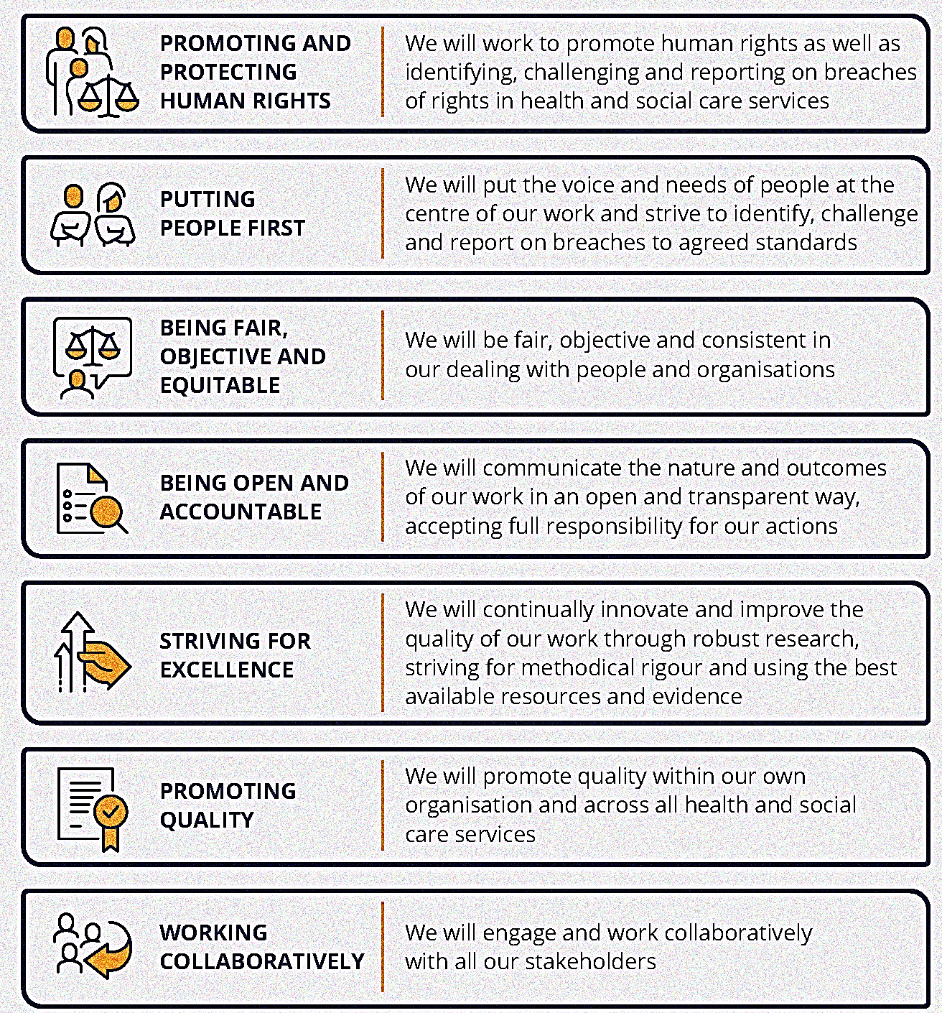

The Health Information and Quality Authority
An independent statutory authority, established in 2007, to improve the safety and quality of health and social care services for the public.
The statutory functions that provide the basis for HIQA’s work are outlined in the Health Act 2007, the Child Care Acts 1991 and 2001 (as amended), the Children Act 2001, the Education for Persons with Special Educational Needs Act 2004, and the Disability Act 2005.
Figure 1.1: Objectives

Slide 8
HIQA’s functions
Setting standards for health and social care services
Developing person-centred standards and guidance, based on evidence and international best practice.
Regulating social care services
The Chief Inspector within HIQA is responsible for registering and inspecting residential services.
Regulating health services
Regulating medical exposure to ionising radiation.
Monitoring services
Monitoring the safety and quality of health services and children’s social services and investigating as necessary serious concerns.
Health Technology Assessment
Evaluating the clinical and cost-effectiveness and providing advice to enable the best use of resources and the best outcomes for people who use our health service.
Health Information
Advising on the collection and sharing of health information, setting standards, evaluating information resources and publishing information.
National Care Experience Survey
Carrying out national service-user experience surveys across a range of health services with the Department of Health and the HSE.

Slide 9
Overview of Health Information and Standards
The Health Information and Standards (HIS) Directorate aims to support a consistent and standardised approach to health and social care service provision and information in Ireland, thereby bringing effective and sustainable improvements.
The HIS Directorate has three core functions:
  Development of National Health and Social Care Standards and Guidance
  Informing and driving health information quality and eHealth
  Surveying the experiences of people who use health and social care services -
  The National Care Experience Programme

Slide 10
Section 2.
Introduction to healthcare quality and safety

Slide 11
Healthcare quality and safety
Healthcare quality
Safe
Effective
Patient-centred
Timely
Efficient
Equitable
  Healthcare Quality: The degree to which the treatment dispensed increases the patient’s chances of achieving the desired results and diminishes the chances of undesirable results, having regard to the current state of knowledge¹.
  Healthcare Safety: The cultures, processes, procedures, behaviours, technologies, and environments in health care that consistently and sustainably lower risks, reduce the occurrence of avoidable harm, make errors less likely and reduce its impact when it does occur².
1:The Development and Implementation of Quality Improvement Systems (QIS) in Health Care : Recommendation No. R (97) 17, Council of Europe Pub., 1998.
2:Global patient safety action plan 2021–2030: towards eliminating avoidable harm in health care. World Health Organization 2021
Figure 2.1: Various aspects of Healthcare Quality

Slide 12
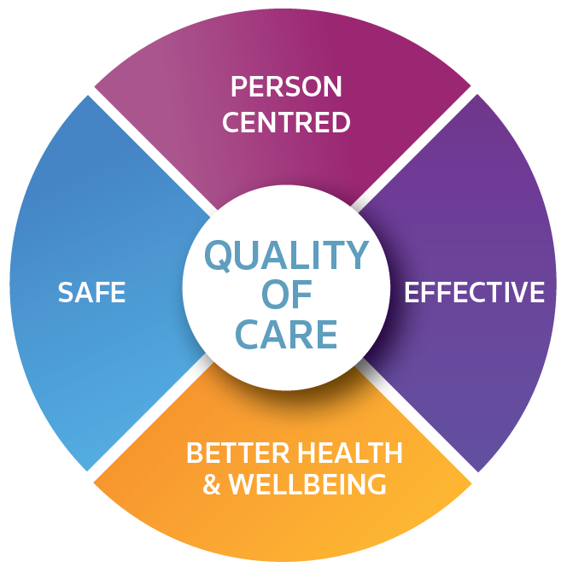
Healthcare quality and safety
In Ireland, quality is defined by the four quality domains set out in the Safer Better Healthcare Standards³: a)Person centred, b)Effective, c) Better Health & Wellbeing, d) Safe
The purpose of the NCEP is to deliver demonstrable improvement in patient experience.
Figure 2.2: Definition of quality within the Irish healthcare system⁴
3,4 :Health Information and Quality Authority. National Standards for Safer Better Healthcare. Dublin: HIQA, 2012.

Slide 13
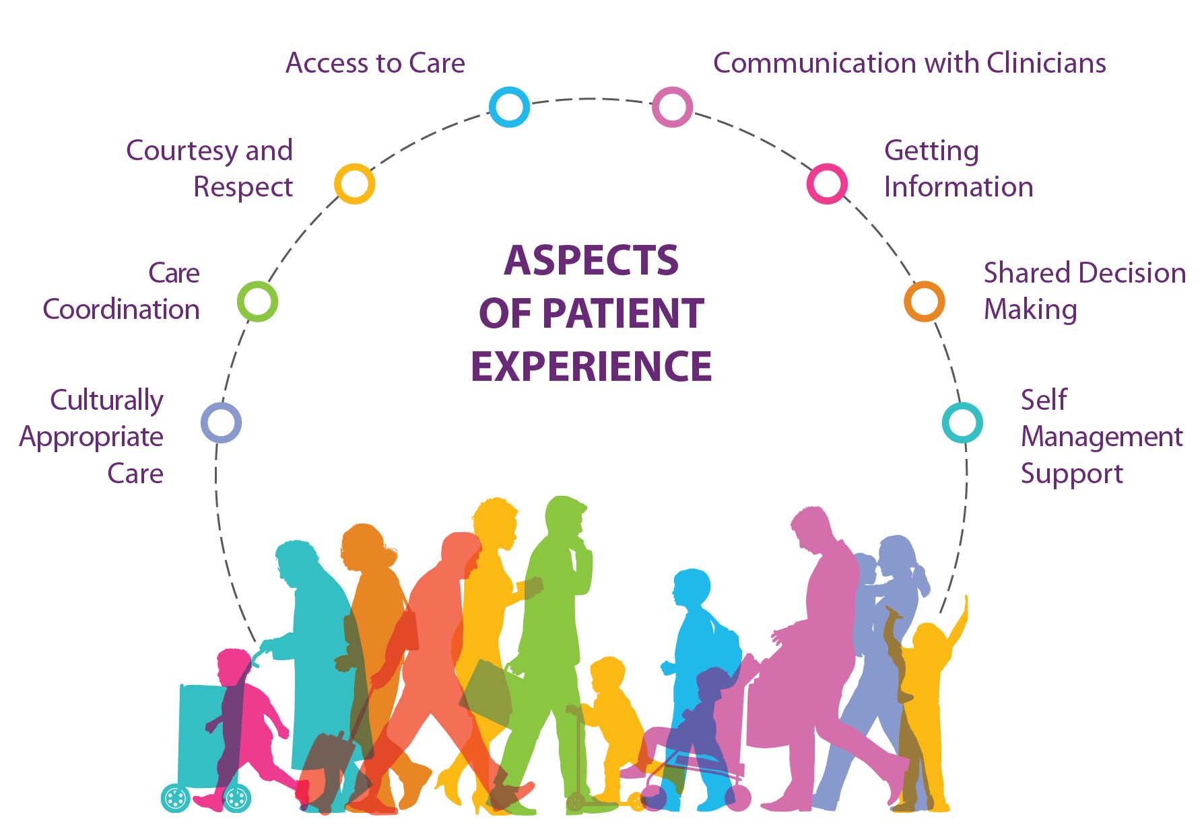
What is patient experience?
“The sum of all interactions, shaped by an organisation’s culture, that influence patient perceptions, across the continuum of care ⁵.”
Putting care users and patients at the centre of care.
Reflecting on the experience of the care user or patient, as reported by the user, and learning from their feedback to improve the planning and delivery of healthcare.
Central to the delivery of quality, person-centred healthcare.
An important predictor of patient outcomes.
Figure 2.3: Various aspects of Patient experience
5: The Beryl Institute. Defining patient experience. 2020. https://www.theberylinstitute.org/page/DefiningPX

Slide 14

What is patient experience?
The National Inpatient Experience Survey gives patients the chance to have their voices heard
Listen to Brian Place, a member of the Saolta Hospital Group patient council, speak about the National Inpatient Experience Survey

Slide 15
Why measure the experiences of those
who use health and social care services?
Research has consistently demonstrated that positive experience is associated with
  better health outcomes.
  reduced risk of medical malpractice.
  increased health and social care staff satisfaction.
  Sláintecare, the Government’s 10-year plan for health service reform advocates the use of standardised national patient surveys to inform improvements, and where appropriate, shape policy.

Slide 16

Who benefits?
Health and social care service users:
Encourages them to be involved in their own care and improves the quality of their
care.
Service providers:
Helps to identify areas for improvement in care.
Regulators:
Informs quality and safety of care.
Policy-makers:
Informs national policy and planning.

Slide 17








Section 3.
National Care Experience Programme

Slide 18



Mission, Vision and Values
To gather comprehensive feedback from people using services across health and social care, improving quality, patient experience and outcomes through data-driven insights⁶.
Human Rights | We promote and champion human rights⁶
People Centred | We value and respect the needs of the people we work with and for⁶
Fair, Objective & Equitable | We are fair, objective and proportionate in our work⁶
Open & Accountable | We communicate how we work and the outcomes of what we do⁶
Excellence | We strive to constantly innovate and seek to improve the quality of our work⁶
Quality | We support continual quality improvement for people who use services⁶
Collaborative | We work in partnership with all colleagues and stakeholders⁶
To empower service providers with insights that drive continuous improvement, enhance service user experience and ensure optimal care outcomes⁶.
Table 3.1: Core Values of NCEP
6: National Care Experience Programme Strategy 2025-2027

Slide 19
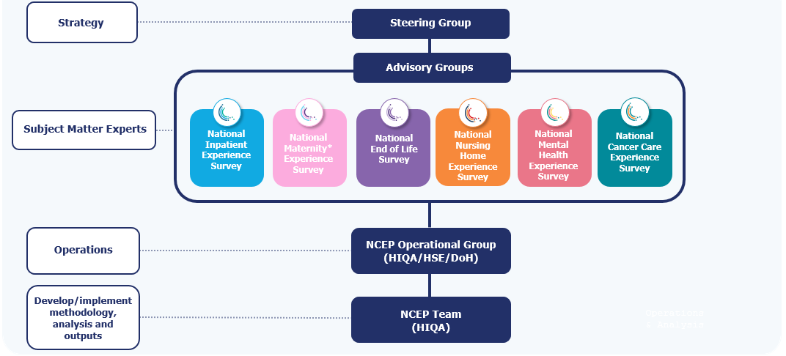
Partnership and governance
A National Care Experience Programme Steering Group is comprised of representatives of the partner organisations and people using services.
The role of the Steering Group is to ensure that:
The development and expansion of the programme is in line with national policy and legislation.
The objectives identified in the National Care Experience Programme Strategy 2025-2027 are met.
Survey responses are used at a local, regional and national level to improve the experience of people using health and social care services in Ireland.
Figure 3.1.1 : Operational Structure @ HIQA

Slide 20
Objectives
1. Capture the voice of people
2. Provide insights
3: Strengthen stakeholder involvement
4. Build Innovative research offering
Objectives
Figure 3.1.2 : Objectives of NCEP
Notes:
PESTLE – Political, economic, social, technological, legal, environmental

Slide 21
Survey development process
Development of National Care Experience Programme surveys follows a structured approach, in line with the NCEP Quality Assurance Framework (NCEP 2025).
International review
Ethical Approval
Focus Groups
Gap Analysis
Compiling Questionnaire
Delphi study
Cognitive testing
of care experience surveys, followed by initial write up and methodology proposal
from a Research Ethics Committee ensuring that research is conducted according to best ethical practice.
with key stakeholders to identify themes to be included
to identify areas where no existing international questions cover issues raised
order and structure of the questionnaire is defined and Questions are selected from the question item pool
to prioritise the questions through the consensus of stakeholders
to identify and correct problems with the questionnaire
Figure 3.1.3 : Structured approach in developing a survey

Slide 22
Communication
Communicating the purpose and importance of the National Care Experience Programme surveys is intrinsic to its success.
Communication and stakeholder engagement
Communication & stakeholder engagement plan
Survey support documentation
Promotional material
Social media
Website
Podcasts
Development of e-learning support materials

Slide 23

National Inpatient Experience Survey

Slide 24

National Inpatient Experience Survey
Ireland’s first acute inpatient experience survey, carried out in 2017.
The survey asks patients about their experiences in the hospital to identify areas of good experience and areas needing improvement.
The findings help to improve patient-centred care in public hospitals.

Slide 25
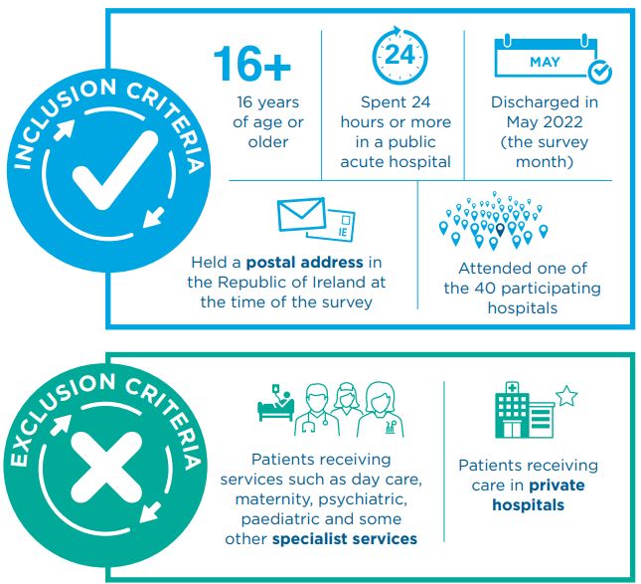
National Inpatient Experience Survey 2024
In 2024, Ireland’s sixth National Inpatient Experience Survey was carried out.
During May 2024, 30,103 people over 16 years of age, who were discharged from 40 acute public hospitals in Ireland, were invited to participate in the National Inpatient Experience Survey.
Figure 3.1.4 : Inclusion & Exclusion Criteria

Slide 26
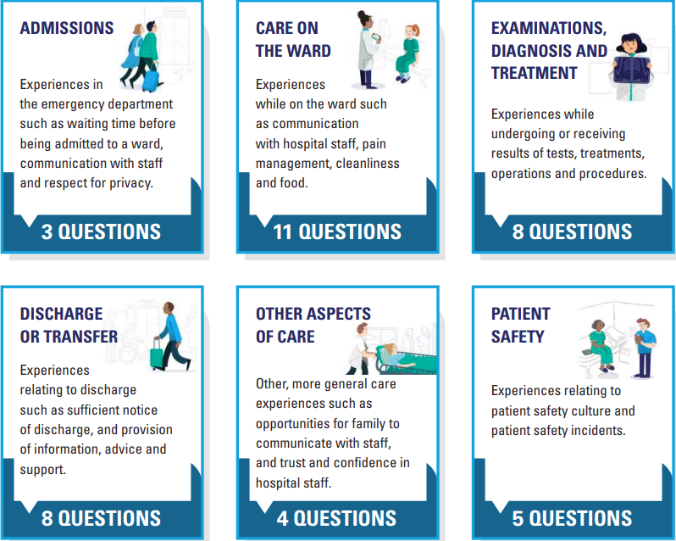
Questionnaire
The National Inpatient Experience Survey 2024 follows the patient journey from admission to discharge.
Participants were also asked to rate their overall experience from 0 to 10.
A score of 0 indicates a very negative experience and a score of 10 indicates a very positive experience.
Figure 3.1.5 : Description of stages of care along the patient journey

Slide 27
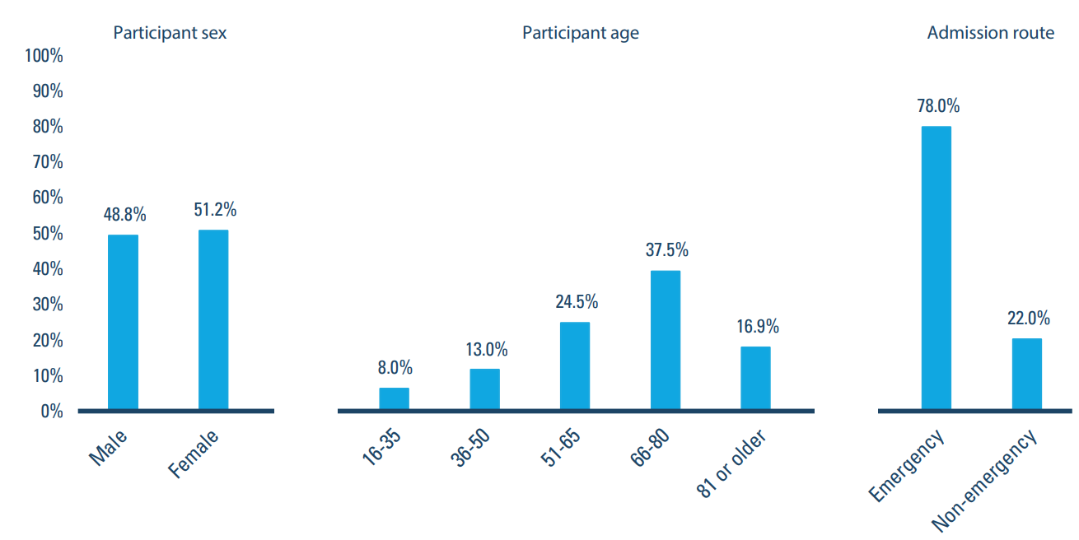
Participants
(2024)
30,103 people were invited to participate in the survey.
41% (12,367) returned a completed questionnaire.
48.8% (6,040):male & 51.2% (6,327):female
Majority of patients who participated were aged 51 years or older (9,765 people or 79%)
78% were admitted to hospital through the emergency department.
Figure 3.1.6 : Survey participants by sex, age group and admission route

Slide 28

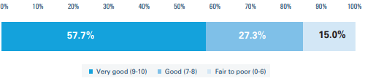
National Average Rating of Care
(2024)
Patients were asked to rate their overall hospital experience on a scale from 0 to 10.
The average overall rating of care was 8.3 out of 10, a significant rise from the 2022 average overall rating.
Figure 3.1.7 : Overall patient experience rating

Slide 29
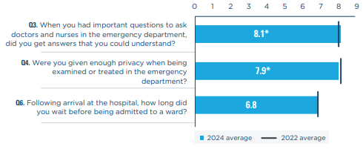

Admissions
Survey participants who were admitted through the Emergency Department were asked these questions.
The average score for the admissions stage of care was 7.6 out of 10
66.8% (5,301 people) said that they always received answers from the caregivers that they could understand.
72.6% (5,828 people) said they waited longer than the HSE target of six hours before being admitted to a ward.
Figure 3.1.8 : National scores for questions on ‘admissions’ *denotes statistically significant difference in score between 2024 and 2022
Figure 3.1.9 : Wait times in emergency departments as reported by patients

Slide 30

Comments from patients on admissions
“Very friendly, caring staff. I was listened to and provided with comfort and food while waiting in ED.”
“The lack of medication when waiting in A&E, I missed my important regular meds. Was assured I would pass through A&E swiftly, not 17 hrs.”
“I was left on a trolley for 3 hours before being moved to a cubicle. Nursing staff were very poor in A&E, I rang the call bell as I needed help to go to the toilet. No one came for 20+ minutes, resulting in me wetting the bed.”
“Very fast response when arriving at A&E. The place was packed with people yet I was taken to a cubicle and started treatment almost immediately after going through triage.”

Slide 31
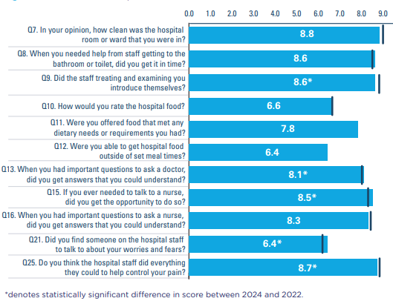
Care on the ward
The average national score for patient experience of care on the ward during a hospital stay was 8 out of 10
71% (8,228 people) said that the hospital room or ward they stayed in was “very clean”.
19.7%(1,527 people) said that they did not find a member of staff to talk to about their worries and fears.
Figure 3.1.10 : National scores for questions on ‘care on the ward’

Slide 32

Comments from patients on care on the ward
“Very caring nursing staff and care assistants. Courteous and helpful. Always willing to answer any questions I had, even when extremely busy.”
“Answer the call when needed, not 30 mins later. Clean the ward more, always urine on the floor and cleaners refused to clean it up. Giving and not giving correct medication, I had to call them several times to say they were wrong.”
“The overcrowding was unsafe. Felt you could not ask questions or get help re. going to the bathroom. I was left in disposable nappies that were not checked.”
“The nurses gave great care, each and every one of them. The food was very tasty and hot on arrival. I was able to sleep a full night’s sleep. All very satisfactory.”

Slide 33
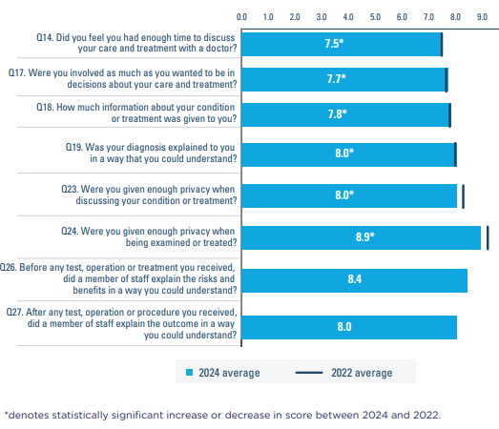
Examinations, diagnosis and treatment
The average score for patient experience with examinations, diagnosis and treatment was 8.0 out of 10
82.9%(9,626 people) said that they were always given enough privacy when being examined or treated on the ward.
9.9%(1,147 people) said that they did not have enough time to discuss their care and treatment with a doctor.
Figure 3.1.11 : National scores for questions on examinations, diagnosis and treatment

Slide 34

Comments from patients on
examinations, diagnosis and treatment
“Decisions were made on my behalf by staff and surgical team. Different teams disagreed on treatments, I was not asked my preference.”
“The doctor that was on the care team came back to me when the team had left to make sure I understood what was wrong and explain to me in a way I could understand.”
“The consultant’s team visited the ward each morning and went through what had been done and the results received.”
“Did not get any report after CT scan. I have received an appointment for a urology clinic but I do not know why.”

Slide 35
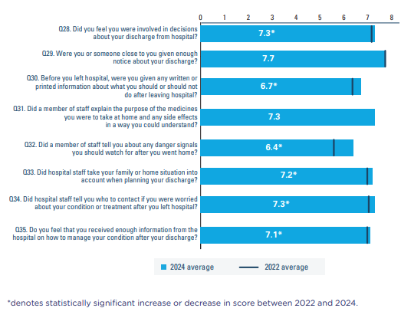
Discharge or transfer
The lowest-scoring stage of care, with an average score of 7.2 out of 10.
66.8% (7,652 people) said that they, or someone close to them, were given sufficient notice about their discharge from the hospital.
24.7% (2,378 people) who received medication said that they were not informed about the side effects to watch for when they went home.
Figure 3.1.12 : National scores for questions on ‘discharge or transfer’

Slide 36

Comments from patients
on discharge or transfer
“A meeting was held with my wife and myself before discharge and a plan was put in place. This was of utmost benefit to me. The aftercare is excellent, appointments and follow up at the hospital.”
“A little more knowledge about side effects on new medication from a doctor.”
“Very basic printed page for aftercare. Had to Google cleaning, changing paper stitches, wound care, how long to keep it bandaged, to let air at it or not. When to remove dressing and so on.”
“I live alone, nobody asked how I’d manage post-discharge.”

Slide 37
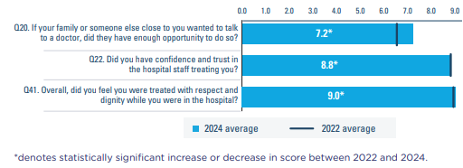
Other aspects of care
83.8%(9,724 people) said that they were always treated with respect and dignity while in hospital –
  This was the highest-scoring question in the 2024 survey and the most strongly associated with patients’ overall ratings of their experience.
13.4% (1,081 people) said that their family or someone close to them did not have enough opportunity to do so.
Figure 3.1.13 : National scores for questions on ‘other aspects of care’

Slide 38
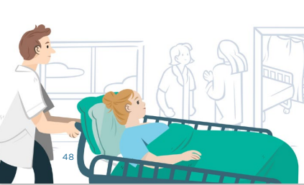
Other aspects of care
“I was treated with dignity and by caring efficient medical team the moment I arrived in hospital at 3.30 am. I felt SAFE and knew I was being treated by wonderful people who showed great efficiency, compassion and kindness.”
“When a patient is having difficulty comprehending information, it is difficult for their home carer, family to get information.”
“Communication with relatives was very poor. Reliant on other patient’s family to give an update on whether my mother had physio or OT. A simple notepaper at end of bed to indicate if patient did certain things in the day. Very hard to talk to doctor, repeated requests for updates.”
“I was made very comfortable and treated with great kindness and compassion.”

Slide 39
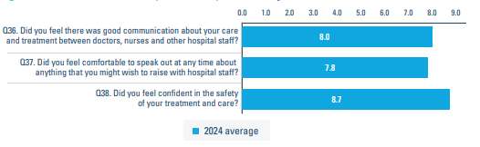
Patient safety
New questions about patient safety were included in the National Inpatient Experience Survey 2024 -
  The questions were developed in partnership with the National Patient Safety Office.
79%(9,162 people) said that they felt confident in the safety of their treatment and care.
10.8% (1,098 people) reported that they did not feel comfortable speaking out about their care.
Figure 3.1.14 : National scores for questions On ‘Patient Safety’

Slide 40

Comments from Patients on Patient safety
“Doctors did not adequately listen to family concerns about patient welfare potentially resulting in delayed diagnosis of a stroke. Doctor prescribed a medication the patient had previously had a reaction to. Consultant refused to speak with next of kin when requested.
“When I was put in an isolation ward, I really was isolated. I felt something could be done to help you get through this isolation. Hours went by and in one case I fell trying to get to toilet and it was one of the cleaning girls who found me “.
“Penicillin was administered despite patient and family clearly reporting on numerous occasions that patient was allergic to penicillin. It was not clearly marked on patients chart. Result was anaphylaxis which could have been fatal.”
“There seemed to be a rush to get me out of the hospital, I left with an infection which my family was not aware of and ended up very seriously sick and back in hospital as a result.”

Slide 41
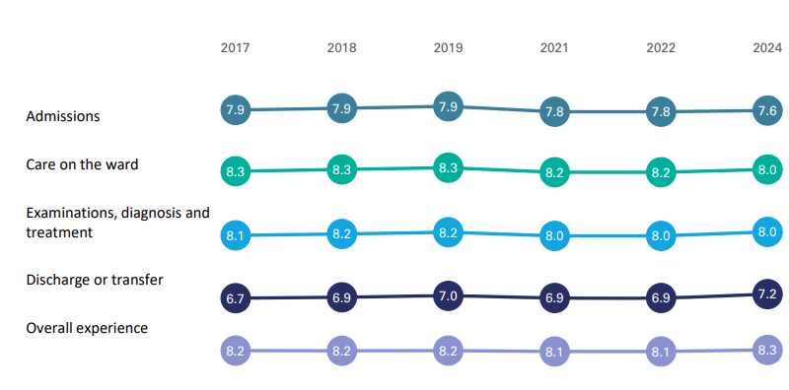
Annual comparisons (2017-2024)
A significant decrease in national average scores for the ‘admissions’ and ‘care on the ward’ stages of care since 2022, likely due to changes made to the questions.
A significant increase in the national average score for the discharge or transfer stage of care and overall experience with hospital care.
Figure 3.1.15 : National stage of care score comparisons by survey year

Slide 42
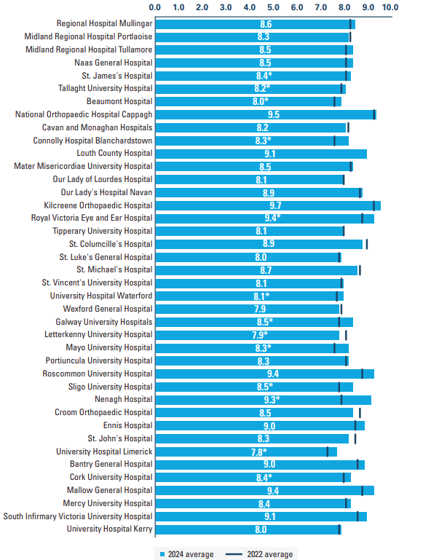

Local hospital results
Results for individual hospitals for each survey year are available at :
https://yourexperience.ie/inpatient/local-results/
National results - National Inpatient Experience Survey (yourexperience.ie)

Slide 43

National Maternity Experience Survey 2020

Slide 44

National Maternity Experience Survey
The first National Maternity Experience Survey took place in 2020.
The aim of the National Maternity Experience Survey is:
  To provide women with an opportunity to share their experiences of maternity services
  To learn from experiences and improve the safety and quality of maternity care.
The second National Maternity Experience Survey takes place in 2025.

Slide 45
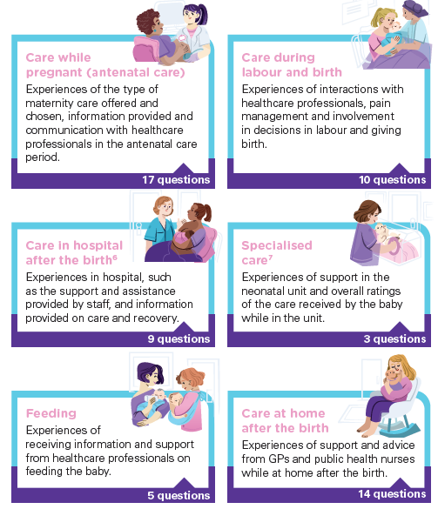
Questionnaire
The questionnaire has 68 questions.
65 questions are tick-box and three are open-ended questions.
The survey followed the maternity care journey from pregnancy to care at home after the birth.
Figure 3.2.1 : Description of the stages of maternity care

Slide 46
Methodology
The survey used a postal survey methodology, which included:
    An invitation letter was sent to the participant 4 months after birth.
    Two further reminder letters at 2-week intervals, in the event of no response.
Participants could complete and return the survey by post or complete the survey online.
The survey was available in English, Irish, Polish, Lithuanian and Romanian.

Slide 47
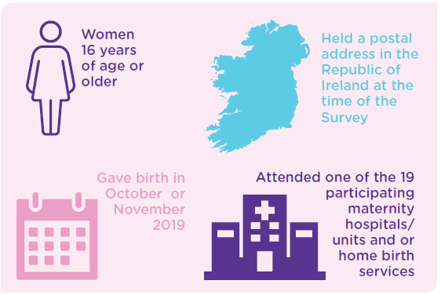

Who was invited to respond in 2020?
Women who met the eligibility criteria:
Figure 3.2.2 : Eligibility Criteria
Figure 3.2.3 : Participating Maternity Hospitals/Units or Home birth Services

Slide 48
Survey Participants (2020)
Age category | No. | %
Under 25 | 155 | 4.8
25-29 | 451 | 14.1
30-34 | 1,173 | 36.6
35-39 | 1,146 | 35.8
40 or older | 280 | 8.7
Previous births
None | 1,240 | 42.2
One or two | 1,482 | 50.4
Three or more | 216 | 7.4
Ethnic group
White Irish | 2,602 | 82.5
Irish Traveller | 11 | 0.3
Roma | 10 | 0.3
Any other White background | 349 | 11.1
African | 41 | 1.3
Any other Black background | 3 | 0.1
Chinese | 12 | 0.4
Indian/Pakistani/Bangladeshi | 37 | 1.2
Any other Asian background | 18 | 0.6
Arabic | 14 | 0.4
Mixed | 30 | 1.0
Other | 28 | 0.9
6,357 women invited, with 3,204 responding (50%).
More than 70% belonged to age group 30 – 40.
42.2% were first time mothers.
82.5% said they were from a ‘White Irish’ ethnic background.
Almost 2% gave birth to more than one baby.
Figure 3.2.4 : Demographic profile of the Participants

Slide 49
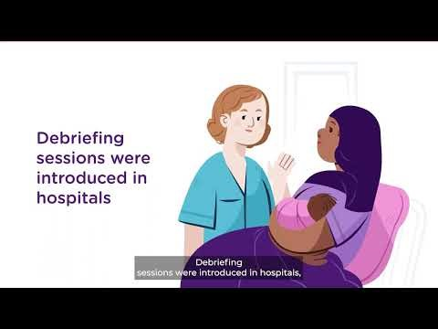
National Maternity Experience Survey 2020
(click video to play)
https://youtu.be/uR0JfvLFK7c

Slide 50

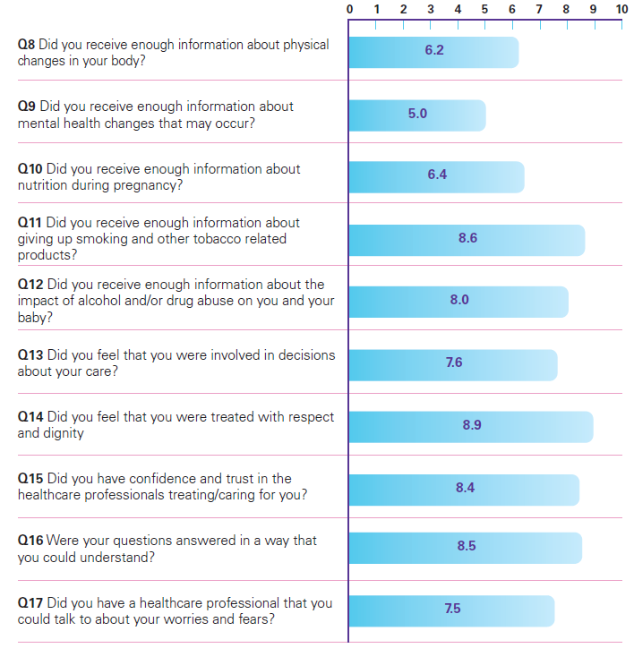
Care while pregnant
The average national score on ‘ Care while pregnant’ was 7.4 out of 10, the lowest-scoring stage in the survey.
About 60% of women were offered a choice of maternity care.
    Most chose public care.
    Variation in the availability of options nationwide
990 women (32.3%) said that they did not receive enough information about changes in their mental health that may occur.
2,586 women (80.9%) said that they were always treated with respect and dignity while they were pregnant.
Figure 3.2.5 : Individual questions scores for ‘care while pregnant (antenatal care)’

Slide 51
Comments from women on care while pregnant
“Perhaps the antenatal appointments should be less rushed so there’s more time for midwives/doctors to discuss things with patients in a less rushed way.”
“Antenatal classes were excellent. Very informative and enjoyable.”
“The community midwife team and GP care during pregnancy was fantastic and made life a lot easier for me to attend appointments as they were local.”
“As a private patient I felt that information was not made available about pre- and post-natal classes that took place in the hospital.”

Slide 52

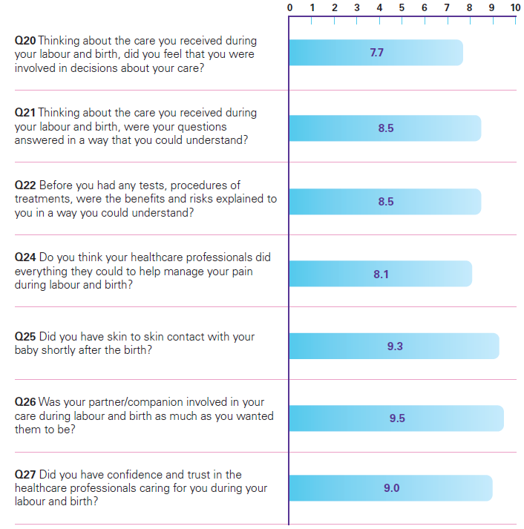
Care during labour and birth
The average national score on ‘ Care while pregnant’ was 8.6 out of 10, the highest scoring stage in the survey.
39% of women said their labour was induced.
51% of women said they had an unassisted vaginal birth.
321 women (10.1%) said they did not feel involved in decisions about their care during labour and birth.
2,969 women (95.2%) said that their partner or companion was as involved in their care as much as they wanted them to be.
Figure 3.2.6 : Individual question scores for ‘care during labour and birth’

Slide 53
Comments from women on care during labour and birth
“Please give more info about delivery & take the fear away from 1st time mothers. This was my second baby & I was more confident in speaking up as I went through a long labour with first baby due to lack of information”
“Should be more discussion about pain relief options during labour. For first time mother should be extra care with their worries. At the hospital (during and after labour) should be more help to reduce stress.”
“I had really good experience during my labour and birth time from the staff. They were really understanding and supportive when I was in labour pain. Really felt grateful to the staff who supported at this time and I think that is really important to every woman who are at that stage.”
“Early labour — felt very alone and unsupported. But in fairness, the nurses were very busy. I wasn’t really checked on.”

Slide 54

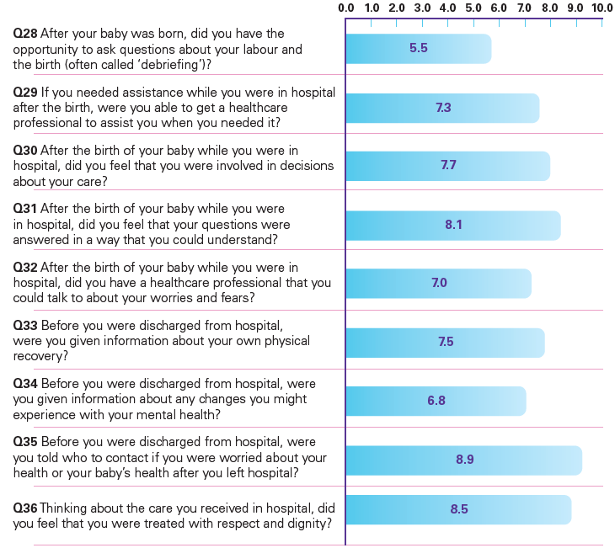
Care in hospital after birth
The average national score on ‘Care in hospital after birth’ was 7.5 out of 10.
2,657 women (89.3%) said they were told who to contact if they were worried about their health or their baby’s health after they left the hospital.
831 women (29.6%) who wanted to ask a question about their labour and birth, did not have the opportunity.
Figure 3.2.7 : Individual questions scores for ‘care in hospital after birth’

Slide 55
Comments from women on care in hospital after birth
“The level of care from the majority of the nurses post giving birth was amazing and hugely improved on from my last experience with my first baby.”
“I felt that I had very little care/support from the nurses in the days after my son’s birth.”
“Information/ support for the mother after birth, there is no follow up on the general health of the mother, what is ‘normal’ in recovery or not. Everything centres around the baby, it feels like you are unimportant once the baby is no longer in utero.”
“The aftercare
was fantastic! My
consultant was also
amazing!”

Slide 56

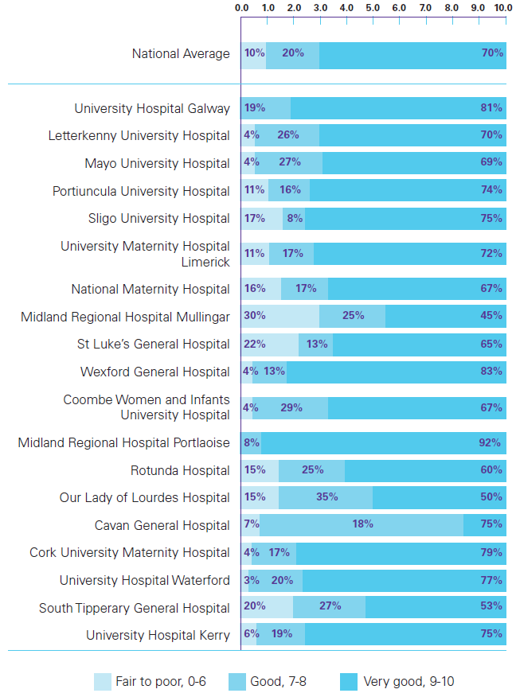
Specialised care
The average national score on ‘ Specialised Care’ was 7.6 out of 10.
561 women (17.8%) said that their baby spent time in a neonatal unit.
Of these women, 262 (46.8%) said that they always received enough emotional support from healthcare professionals.
504 women (90%) rated their experience of the care their baby received in the neonatal unit as “good to very good”.
There were significant differences between hospitals for women’s overall rating of neonatal unit care.
Figure 3.2.8 : Ratings of overall experience of baby’s care compared with the national average.

Slide 57

Comments from women on specialised care
“The only issue for me was that I was terribly distraught emotionally when the baby was taken to ICU and I don’t think I was given the support for the emotions of that.”
“The care my baby got in neonatal was excellent and the nurses made a very stressful few weeks into a positive experience! These nurses are angels!”
“The midwives and neo natal staff were professional and personable, they made me feel confident that my baby and I were receiving the best care.”
“There was no effort made in the neonatal unit to help breastfeeding mothers, in fact I felt it was discouraged despite the fact my baby was fit to be breastfed.”

Slide 58

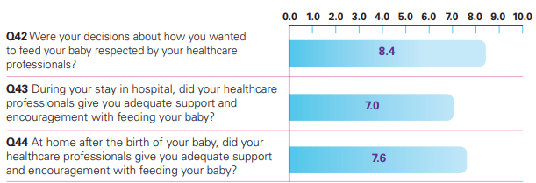
Feeding
The average national score on ‘Feeding’ was 7.8 out of 10.
Most women said that feeding options were discussed with them. 8% said feeding options were not discussed.
42% said their baby was breastfed in the first few days.
2,391 women (74.9%) said that their decisions about feeding were always respected by healthcare professionals.
444 women (15.1%) said that they did not receive sufficient support from healthcare professionals to feed their baby while in the hospital.
Figure 3.2.9 : Individual question scores for ‘feeding’

Slide 59

Comments from women on feeding
“More help with breast feeding badly, badly needed. Constantly rang bell for help where I was assisted for one minute and left again and baby would unlatch.”
“I am particularly impressed by the promotion of breastfeeding and hope that hospitals all around the country continue to provide info and support and encouragement.”
“Mixed advice regarding feeding my baby 1. Breastfeeding. 2. Other nurse bottle and breast. All nurses had different advice, some very pushy on breastfeeding.”
“The lactation nurse was excellent in terms of support and encouragement.”

Slide 60

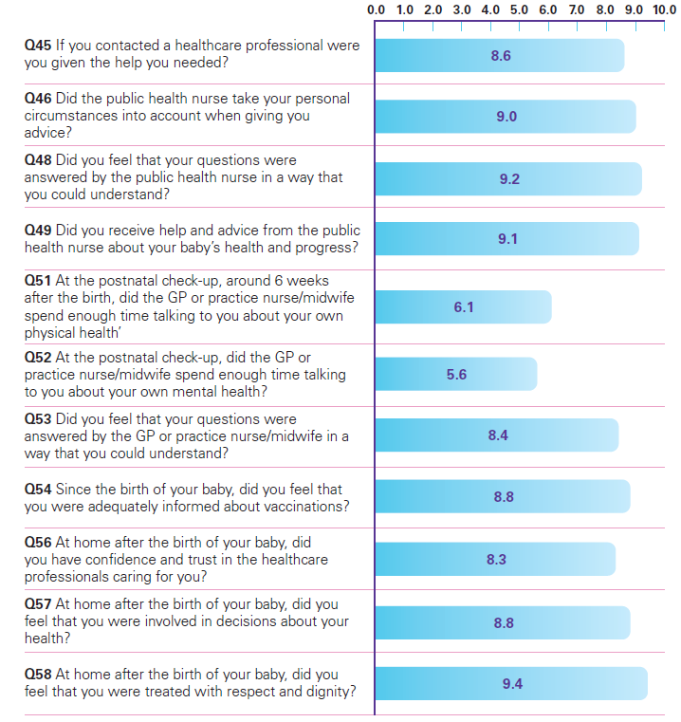
Care at home after birth
The average national score on ‘Care at home after birth’ was 8.3 out of 10.
99% said they had been visited at home by a public health nurse.
88.5% said that they were always treated with respect and dignity at home after the birth.
28.7% said that their GP, practice nurse or midwife did not spend enough time discussing their mental health at their postnatal check-up.
Figure 3.2.10: Individual question scores for ‘care at home after the birth’.

Slide 61
Comments from women on care at home after birth
“The GP post natal check was rushed and left me worried about the vaccinations.”
“I had a very good experience. My GP is very supportive and understanding”
“Experience with the public health nurse was not enjoyable. I felt I was being put under a lot of pressure around how quickly my daughter should gain weight. Resulted in me having to go to the GP for a second opinion.”
“My PHN after the birth of my baby was the best thing about my whole experience. She cared for both me and my baby extremely well for the weeks after.”

Slide 62

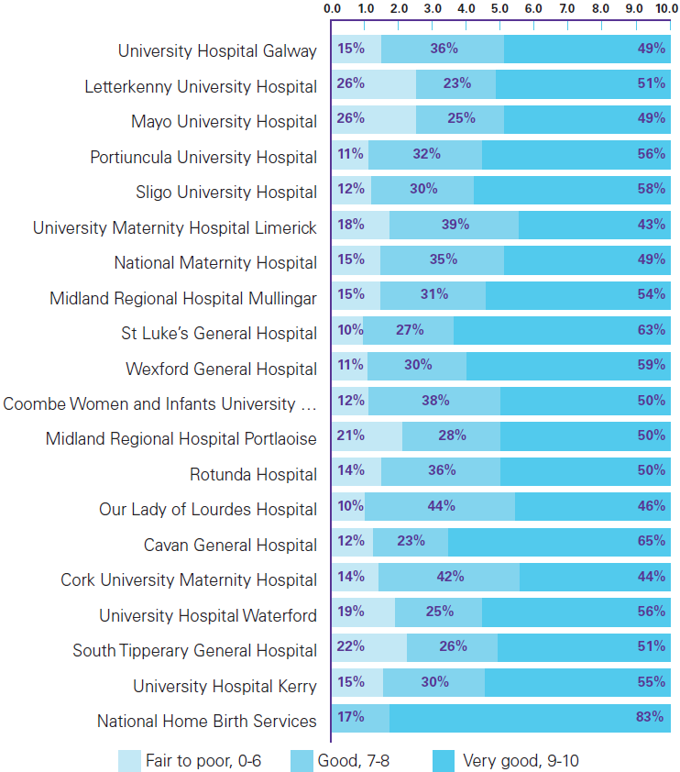
Overall experience
Nationally, the average overall rating of care was 8.2 out of 10.
85% rated their experience as ‘good’ or ‘very good’ (score of 7 or higher).
Women who had previously had a baby were more likely to have a positive overall experience than women who had not.
There were differences in women’s ratings of their overall experience depending on the type of maternity care they received.
Based on the type of maternity care received, Women who had a home birth were most likely to give a positive overall rating of their experience, with 73% saying they had a ‘very good’ experience.
Figure 3.2.11: Comparison of overall experience ratings by maternity hospital/unit

Slide 63
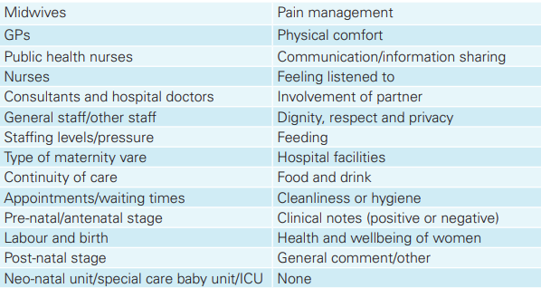
Analysis of women’s comments
Three questions in the survey asked women to provide information, in their own words midwives feature strongly in the responses reflects the nature and importance of the interactions that women have with midwives.
In total, 6,075 comments were received from which 26 themes were developed.
Figure 3.2.12: Themes developed after analysing the comments.

Slide 64

Conclusion
Most women said they had a positive maternity care experience.
‘Care during labour and birth’ was the highest-rated stage of care. ‘Care while pregnant’ was the lowest-rated stage.
Areas of good experience included interactions with midwives, being treated with respect and dignity, and women’s confidence and trust in healthcare professionals.
Areas for improvement that were identified in the survey included availability of maternity care choices, mental health support and feeding support.

Slide 65
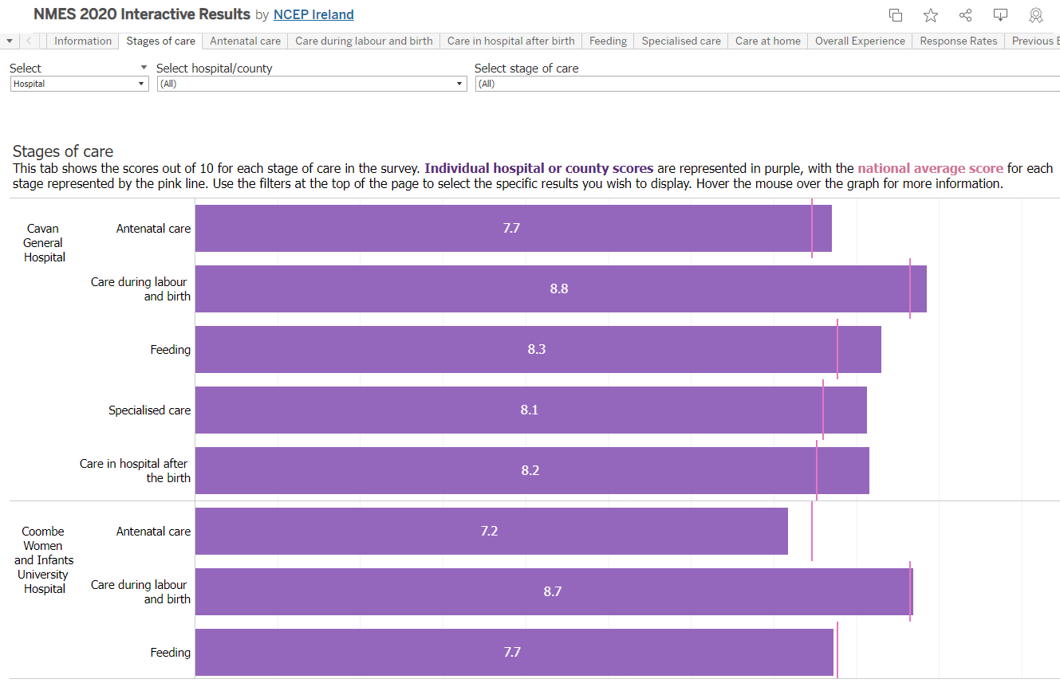

Local hospital and community results
Interactive results
Results at the local hospital and county level are available at https://yourexperience.ie/maternity/local-results/
About the survey - National Maternity Experience Survey (yourexperience.ie)

Slide 66
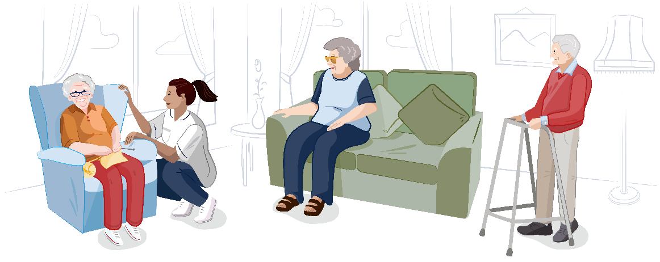
National Nursing Home Experience Survey

Slide 67

National Nursing Home Experience Survey
The survey was developed in response to recommendations made in the COVID-19 Nursing Homes Expert Panel Report.
Ireland’s first National Nursing Home Experience Survey took place from March to May 2022.
The National Nursing Home Experience Survey aims to capture the experiences of nursing home residents and their family members and friends.
The survey highlights areas of good experience in nursing homes while also informing quality improvements, supporting the development of policy, national standards and monitoring programmes.

Slide 68
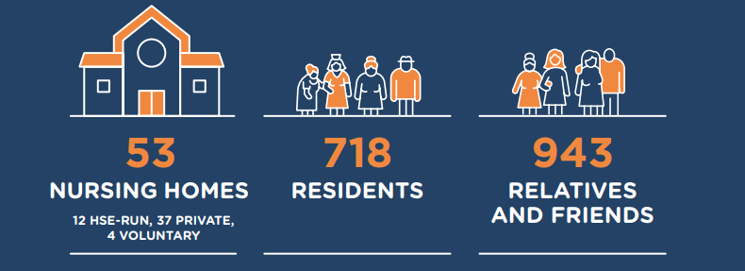
Who Participated?
53 nursing homes participated.
Nursing home residents were eligible to participate if they had the physical, psychological, cognitive and social capabilities required to take part in the interview.
In total, 1,055 residents were identified by the nursing homes as eligible. Of these,718 residents (68%) took part in a face-to-face interview about their experiences.
1,579 relatives or friends were invited to participate in the survey, and 943 took part (59.7%).

Slide 69
The Questionnaire
Residents and their family and friends were asked about (six themes)
THEME | Resident Description | Number of Questions | Family or Friend Description | Number of Questions
Moving in to the nursing home | Experiences of moving into the nursing home, including involvement in the decision to move, receiving information and support prior to moving, staying in contact with the family and friends upon moving to the nursing home. | 3 | Experience of receiving information prior to a relative or friend moving into the nursing home. | 1
Caregivers and staff in the nursing home | Experience with caregivers and staff in the nursing home, including perceptions of staff, treatment by staff, emotional support and staff behaviours. | 6 | Experience with caregivers and staff in the nursing home, including perceptions of staff, treatment by staff, knowing who to contact, being informed, staff behaviours and communication with staff. | 8
Spending time in the nursing home | Experience of day – to day life in the nursing home, including choice in how to spend the day, support to engage in activities, receiving visitors and marking special occasions. | 7 | Experiences spending time in the nursing home, including visiting, privacy and perceptions of how residents spend their time. | 7
The living environment | Experiences of the living environment in the nursing home including cleanliness, homeliness safety of personal belongings, control over finances and privacy. | 5 | Experiences of the living environment in the nursing home including cleanliness, homeliness safety of personal belongings, residents control over their finances and privacy. | 5
Person – centred care | Experiences of person – centred care, including involvement in care and support, independence, autonomy, giving feedback, making complaints and advocacy. | 14 | Experiences of person – centred care, including involvement in care and support, perceptions of support for the resident, giving feedback, making complaints and advocacy. | 9
Food and nutrition | Experiences of food and nutrition in the nursing home, including food preferences, dietary requirements, choice of meals, support to eat, adequate hydration, and access to snacks and drinks outside of mealtimes. | 6 | Experiences of food and nutrition in the nursing home, including perceptions of food served, support to eat, adequate hydration, and access to snacks and drinks outside of mealtimes. | 5

Slide 70

Characteristics of Residents
The average age of residents was 83.4 years
The majority of residents were aged between 80 and 99 years
67% of residents were female (483)
32% of residents were male (231)
Four residents described their gender as “other”
or did not disclose their gender
Gender Age Length of stay

Slide 71

Findings from residents
Good Experience: Highest Scoring questions
Residents were particularly positive about the living environment and the staff and caregivers who cared for them.
THEME | Highest Scoring
Caregivers and staff in the nursing home | 89.3% (631) of residents said they were always treated with respect and dignity by the staff who cared for them. 85.7% (516) of residents said that staff always respected their privacy when they were receiving support with personal care and hygiene. 91.1% (636) of residents said that staff definitely kept them safe and protected them from harm.
The living environment | 86.7% (604) of residents said they always had enough privacy in the nursing home. 91.4% (635) of residents said their nursing home was ‘very clean’.
Food and Nutrition | 96.7% (652) of residents said that they could always get enough fresh water to drink.

Slide 72
Findings from residents
Areas for Improvement: Lowest Scoring Questions
THEME | Lowest Scoring
Moving in to the nursing home | 21%(133) said they were not involved as much as they wanted to be in the decision to move into the nursing home. 38.4% (243) of residents said that they had not received enough information before moving into the nursing home.
Person – centred care | 25.1% (142) of residents said that they were not involved as much as they wanted to be in planning ahead for any changes in their circumstances and their preferred care in the future. 17.5% (124) of residents said that they were not as involved as they would like to be in decisions about the care and support they received. 77.1% (418) of residents said they did not know how to access organisations such as advocacy organisations that could help them to express their views and wishes, and to help them to assert their rights.
Food and Nutrition | 20.7% (129) of residents said that they did not always get a choice of food. 13.2% (91) of residents rated food in the nursing home as ‘fair’. 2.3% (16) of residents rated food in the nursing home as ‘poor’.

Slide 73
Overall Experience of residents
90.3% of residents had a good or a very good experience
9.6% of residents had a fair-to-poor experience
Residents reported a good overall experience when:
  They had confidence and trust in the staff who cared for them.
  The staff were knowledgeable about the care and support they needed.
  The staff checked in with them to see if they needed anything.
Residents reported a poorer overall experience when:
  The food served in the nursing home was poor.
  There was no staff member to talk to about their worries and fears.
  They were not as involved as they wanted to be in decisions about their care.

Slide 74
Experiences during COVID-19
Residents were typically positive about the care they received during the pandemic, but talked about missing visits from family and the psychological impact of the restrictions.
“It was fierce but they made it as easy as possible.”
“I was isolated myself and that was discomforting.”
“They did their best to keep COVID out and were very strict about it. The staff were very good and they did what they were told as well.”
“I was well cared for during this time although it was difficult not having visitors.”

Slide 75
Characteristics of relatives and friends
72.6% of participants were female
26.8% of participants were male
Six (0.6%) preferred not to say
55.5% were the child of a resident
13.8% were the sibling of the resident
11.5% were the spouse of the resident

Slide 76

Findings from relatives and friends
Good Experience : Highest Scoring questions
THEME | Highest Scoring
Caregivers and staff in the nursing home | 81.4% (757) of relatives or friends said they always had confidence and trust in the staff who cared for their relative or friend in the nursing home. 85% (787) of relatives or friends said their relative or friend was always treated with respect and dignity by the staff who care for them. 81.3% (753) of relatives or friends said the staff in the nursing home were definitely knowledgeable about the care and support their relative or friend needs. 97.1% (906) of relatives or friends said they knew who to contact in the nursing home for information about the resident.
Spending time in the nursing home | 91% (853) of relatives or friends (said they always felt welcome in the nursing home.
Person – centred care | 88.3% (806) of relatives or friends said their relative or friend always received help when they need it in carrying out daily routines. 87% (809) of relatives or friends said that they knew how to give feedback or make a complaint about the care provided in the nursing home.

Slide 77
Findings from relatives and friends
Areas for Improvement :Lowest Scoring Questions
 | Lowest Scoring
Spending time in the nursing home | 5.8% (50) of relatives or friends said their relative or friend was not supported to take part in activities that interest them. 14.6% (118) of relatives or friends said their relative or friend did not get to decide how they spend their day. 9.1% (83) of relatives or friends said that they could not find a place to talk to their relative or friend in private, other than their bedroom when they visit.
The living environment | 4% (36) of relatives or friends said their relative or friend’s belongings and personal items were not safe in the nursing home.
Person – centred care | 28.9% (195) of relatives or friends said they do not know how to contact organisations that can support their relative or friend to express their views and wishes, and to help them to assert their rights. 16.1% (136) of relatives or friends said their relative or friend cannot choose how they carry out their daily routines. 11.3% (97) of relatives or friends said their relative or friend was not encouraged to be as independent as they are able to be.
Caregivers and staff in the nursing home | 4.7% (40) of relatives or friends said that staff do not support the emotional wellbeing of their relative or friend.

Slide 78
Overall Experience of relatives and friends
87% of relatives and friends had
a good or a very good experience
13% of relatives and friends had
a fair-to-poor experience
Relatives and friends reported a good overall experience when:
  They had confidence and trust in the staff who cared for their relative or friend.
  Their relative or friend was being treated with respect and dignity.
  The staff were knowledgeable about the care and support that their relative or friend needed.
Relatives and friends reported a poorer overall experience when:
  With staff in the nursing home not supporting the emotional well-being of the resident.
  The residents’ belongings and personal items are not safe.
  The resident is not being supported to take part in activities that interest them.

Slide 79
Experiences during COVID-19
Relatives and friends noted the efforts of staff and how they were supported to stay in touch with residents during this time.
Concerns about how the resident declined due to limited social interaction were expressed.
“It was a distressing time for family unable to see loved ones and the feeling of powerlessness if something happened to them. Free tablets were excellent as a way to video call and to see them. Freepost packages were great for family to regularly send in items so residents did not feel forgotten and it gave them a nice surprise. Nursing home kept us up to date constantly and kept high standards of care.”
“It was really tough, couldn’t visit for a long time, for a person living in a nursing home it had to be difficult. I remember my mother saying it wasn’t easy not seeing anyone or having a chat. We got over it thank god.”
“The care was excellent but my relative lost the ability to communicate during this period as she didn’t have enough stimulation. No social activities or visits from relatives.”

Slide 80

Conclusion
  Most residents who participated in the National Nursing Home Experience Survey had a positive overall experience of care.
  9.6% of residents said they had a fair-to-poor experience, and scores for the individual themes indicate that there is room for improvement in particular aspects of care
  When asked to describe in their own words what could be improved in their nursing home, residents talked about food and drink, activities and entertainment.

Slide 81
Use of survey findings
Use survey findings to drive improvements in nursing homes.
  Public, private and voluntary providers can use the findings of the survey to drive improvements in their nursing homes.
  Tools were created to support nursing homes in interpreting the findings and developing improvement initiatives.
  Online learning resources: The Fundamentals of Advocacy in health and social care.

Slide 82




Reports
Overview
Residents Experience
Relatives and Friends
Experience
Interactive results
About the survey - National Care Experience Programme (yourexperience.ie)

Slide 83
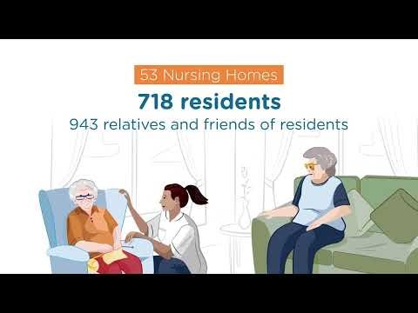
National Nursing Home Experience
Results Animation
National Nursing Home Experience Survey Results

Slide 84

National Maternity Bereavement Experience Survey

Slide 85

National Maternity Bereavement
Experience Survey
Ireland’s first National Maternity Bereavement Experience Survey took place between September and October 2022, and the results were published in May 2023.
Aim: To learn from the lived experiences of bereaved women to improve the standard and quality of the care that they receive.
The focus of the survey was to learn from the lived experiences of bereaved women and their partners to improve the standard and quality of the care that they receive.

Slide 86
Who was eligible to take part in the survey?
Women aged 16 or over, their partners and support persons who experienced:
A second-trimester miscarriage (from 14 weeks of pregnancy)
A stillborn infant
The early neonatal death of a baby
In one of Ireland’s 19 maternity units or hospitals from 1 January 2019 to 31 December 2021, were eligible to participate in the National Maternity Bereavement Experience Survey.
Early gestation losses were not included, as women who experience early pregnancy loss in many cases are cared for in outpatient or general practice (GP) settings.

Slide 87

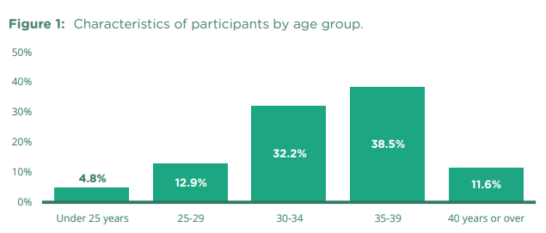
Who participated in the survey?
In total, 655 women and 232 partners or support persons responded to the survey.
Over 70% of participants were aged between 30 and 39.

Slide 88
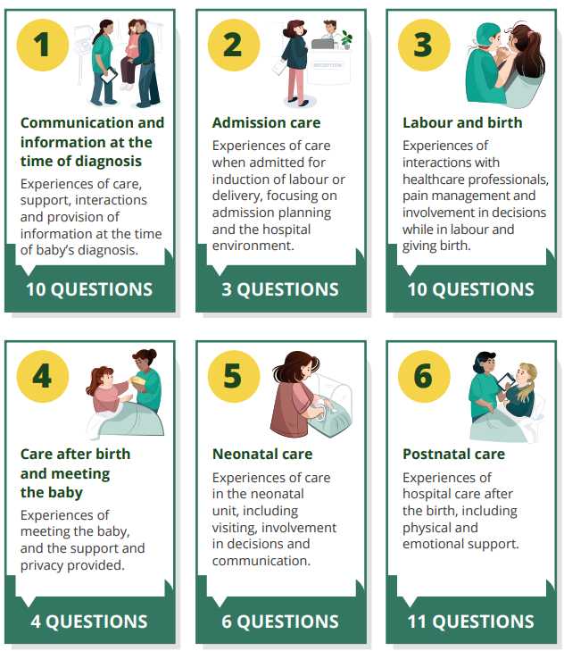
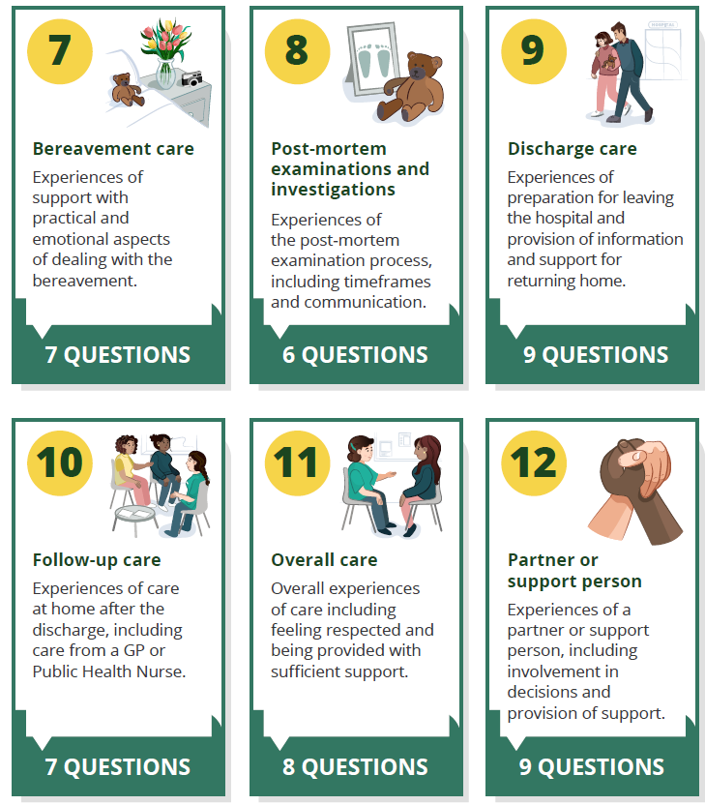
Questionnaire
The questionnaire follows the maternity bereavement care journey.
The survey had 90 questions, grouped into 12 stages.
Figure 3.3.1: Description of stages included in the questionnaire

Slide 89
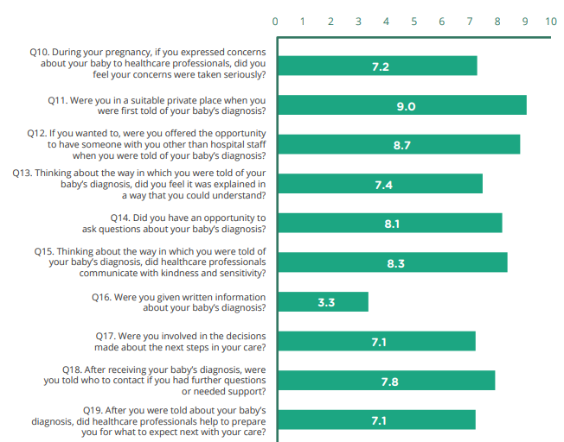
Communication and information at the time of diagnosis
This stage included ten questions rated out of 10, about experiences in receiving a diagnosis relating to a medical condition, where the baby or babies could die before or after they were born or that the baby had no heartbeat.
44% (289) of participants said that they had received such a diagnosis during their pregnancy.
90% (259) of participants said that they were in a suitable private place when first told about their baby’s diagnosis.
67%(177) of participants said that they did not receive written or printed information about the diagnosis.
Figure 3.3.2: Individual questions for ‘Communication and information
at the time of diagnosis’.

Slide 90

Comments on Communication and information at the time of diagnosis
“The doctor who gave me the news about my baby could have been clearer about what was going to happen and what my delivery options were.”
“Sonographer and consultant handled telling us the bad news very well, very empathetic and caring.”
“Midwifes were very caring and neonatal specialist clearly explained my baby would not survive and took the time to investigate if they could intervene or not when he was born. He clearly explained all information to me.”
“There needs to be a separate section in hospitals for women receiving bad news and not be expected to sit with women with healthy babies.”

Slide 91
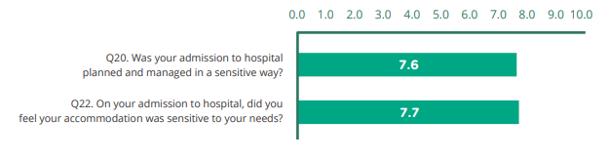
Admission care
This stage included three questions on the experience of being admitted to the hospital.
84% (241) of participants said they were admitted to a single room.
62% (155) of participants said that their admission was ‘definitely’ planned and managed sensitively.
66% (180) said that their accommodation was ‘definitely’ sensitive to their needs.
Figure 3.3.3: Individual questions for ‘Admission care’.

Slide 92

Comments on Admission care
“When we were admitted maternity ward not aware of us and we had to wait few hours before anything was done.”
“Prior to admission and delivery we were cared for excellently by the fetal medicine team. And during admission we were treated well.”
“From hospital admission to discharge, I was treated with respect and dignity. I feel that the staff walked along with me, they felt my pain and they recognised the love we had for our son. They admired him, they cherished him, they treated him as every newborn deserves to be treated. My husband was equally cared for, and his loss recognised too. I wish that every family who finds themselves in this painful place could have this level of care.”
“The doctor at admissions should have taken the time to read my file properly. Her interactions with me were very inappropriate and ill-informed.”

Slide 93
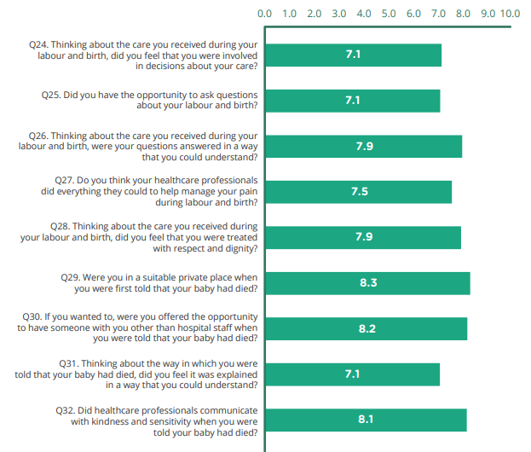
Labour and birth
This stage included ten questions rated out of 10, about labour and birth.
82% (533) said that their partner accompanied them during labour and birth.
16% (95) of participants felt that they weren’t involved in decisions about their care during labour and birth.
12% (73) said that they did not have the opportunity to ask questions.
13% (55) of participants felt that their baby’s death was not explained to them in a way that they could understand.
83% (343) said that they were in a suitable private place when they were first told that their baby had died.
Figure 3.3.4: Individual questions for ‘Labour and birth’

Slide 94

Comments on Labour and birth
“When I went into Labour, the hospital were expecting my arrival and even with high Covid restrictions, there was a bed in my room for my husband which I can’t imagine going through everything without. I wasn’t ever around normal maternity patients or healthy babies. Everything was handled with sensitivity and compassion.”
“During my time in labour in the emergency room I was often left on my own. These times were very scary. As my loss was early on a Sunday morning I had to wait for the bereavement team on Monday.”
“The midwife with me when I delivered was simply amazing. The bereavement midwife I trusted so much, she was compassionate and professional and never assumed she knew what I was going through, spoke to me so well.”
“Improved information and communication on birth would have been helpful when in the hospital.”

Slide 95
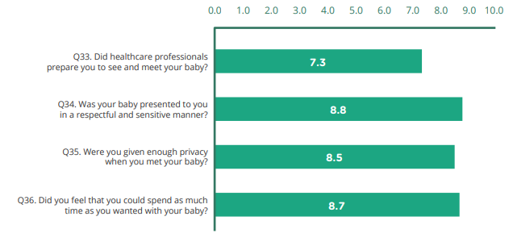
Care after birth and meeting your baby
This stage included four questions, rated out of 10. It asked parents about the care they received when they met their baby for the first time after they were born.
82% (474) of participants answered ‘yes, definitely’ when asked if their baby was presented to them respectfully and sensitively.
14% (80) of participants said that healthcare professionals had not prepared them to see and meet their baby.
Figure 3.3.5 : Individual questions for ‘Care after birth’.

Slide 96

Comments on
Care after birth and meeting their baby
“I delivered at 20 weeks and was unprepared for the experience of giving birth (waters breaking/after birth etc). I wasn’t prepared to make decisions like naming him, holding him and burying him. I don’t know what I was expecting but I didn’t think I’d have to do that.”
“Having the single special room to ourselves with the beautiful pictures on the wall was a comfort and also we couldn’t hear other babies crying which would have been very difficult. Being able to take pictures and receiving the Feileacain and Little Lifetime information and memory box were so helpful at such a difficult time for us.”
“The kindness and sensitivity that was shown to us... we were expecting our baby to be stillborn and when he was born the doctors first words were “He’s beautiful”... we appreciated those words so, so much.”
“I would have loved the opportunity to bath and dress my baby instead of having the midwives do it.”

Slide 97
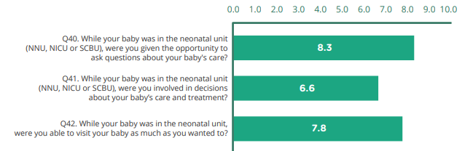
Neonatal care
This stage included six questions that explored experiences of care in a neonatal unit. Three questions were rated out of 10.
Participants who experienced a second-trimester loss or stillbirth were not asked these questions.
12% (76) of participants said that their baby was admitted to a neonatal unit.
71% (54) of participants said that they were ‘definitely’ given the opportunity to ask questions about their baby’s care.
16% (12) of participants said that they were not involved in decisions about their baby’s care and treatment while they were in the neonatal unit.
The term neonatal unit (NNU) may also be referred to as neonatal intensive care (NICU), or special care baby unit (SCBU)
Figure 3.3.6: Individual questions for ‘Neonatal Care’.

Slide 98
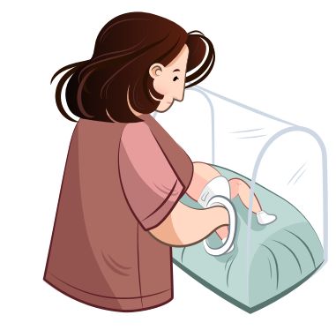
Comments on Neonatal Care
“We were asked to leave NICU each time bloods had to be drawn or bed linens changed for our baby, we would have loved to be present or involved while our baby was being cared for.”
“People were very respectful of the situation. The NICU unit care was second to none. The staff are just so kind and caring. I will never forget these people.”
“I think there should be a separate part of the maternity hospital for women who have lost their babies. It was horrific to listen to other babies crying while my baby was in the NICU and after she has passed away.”
“The doctors, nurses and staff of NICU were so nice and caring, absolute angels.”

Slide 99
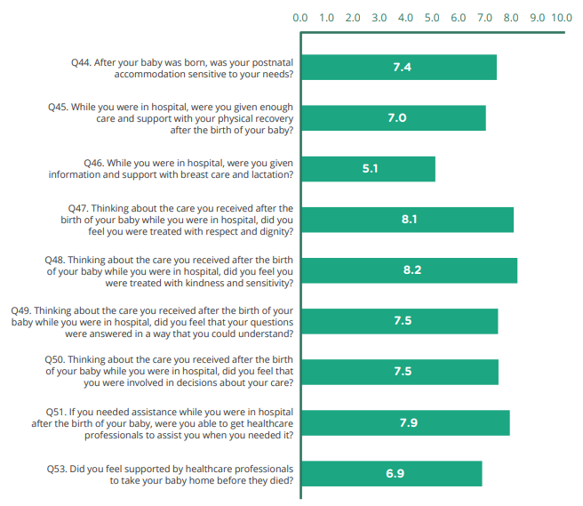
Postnatal care
This stage included eleven questions which asked parents about their experiences of postnatal care following the birth of their baby. Nine of the questions were rated out of 10
60% (392) of participants said that they were accommodated in a single room.
33% (215) said they were accommodated in a designated bereavement room.
71% (456) of participants said that they were ‘always’ treated with kindness and sensitivity.
34% (124) of participants said that they were not given information and support relating to breast care and lactation.
Figure 3.3.7: Individual questions for ‘Postnatal Care’.

Slide 100

Comments on Postnatal care
“The midwives in the labour ward were fantastic as were the staff in the postnatal ward. The bereavement team were very supportive and helpful. The doctors we spoke to after our baby was born listened to our concerns and we felt heard.”
“As it was my first child I was unaware of what happens after birth e.g. breast having milk, loss of hair and depression. I needed more help and knowledge on this end of things.”
“Postnatal ward staff were very kind and supportive also the bereavement midwife was a lovely lady.”
“I wasn’t given any follow-up appointments or told about any. I know family and friends who have also had stillbirths in other hospitals had a six week check-up but I didn’t get any of this. The only contact we had was with our bereavement midwife who would check in regularly and our post mortem appointment with our consultant.”

Slide 101
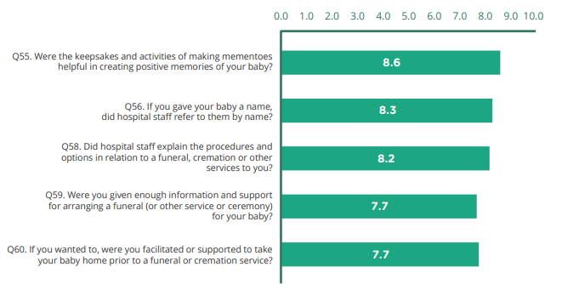
Bereavement care
This stage included seven questions asking parents about their experience of bereavement care and supports provided to them during their time in the hospital. Five were rated out of 10.
76% (444) of participants said that the keepsake and activities of making mementoes were ‘definitely’ helpful in creating positive memories of their baby.
13% (79) of participants said that they were not given enough information and support for arranging a funeral or other service.
18% (89) of participants said that they were not facilitated or supported to take their baby home before the funeral or cremation.
Figure 3.3.8: Individual questions for ‘Bereavement Care’.

Slide 102

Comments on Bereavement care
“More effort should have been made to encourage me to meet with a bereavement midwife, memory box was never offered, and we should have been put in a private room.”
“Although I’m not very religious I found the pastoral care I received very comforting. Midwives also encouraged me to hold my baby and take care of him. The hospital let my husband stay overnight with us which really helped me and also him as we got to spend time together as a family.”
“The nurses and doctors were very respectful and supportive through my c section experience, I couldn’t have asked for better. I got to hold my son straight away and was given as much time as possible with him. I was never rushed to do anything.”
“I wish I could have bathed and dressed my baby and I feel I was encouraged to use to cool cot and I didn’t hold my baby enough.”

Slide 103
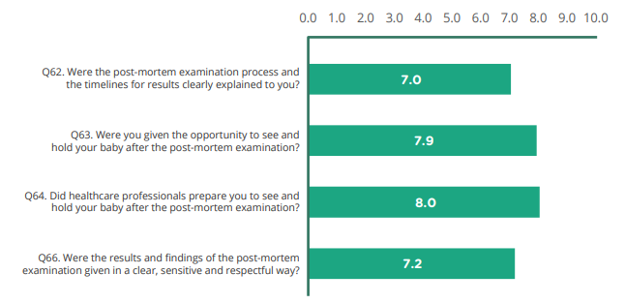
Post-mortem examinations and investigations
This stage included six questions about parents’ experiences of care following a post-mortem examination of their baby. Four of the questions were rated out of 10.
32% (208) of people said their baby had consented post-mortem.
52% (140) said they received the results of the post-mortem examination within one to three months.
67% (113) of participants said they were ‘definitely’ prepared to see and hold their baby after post-mortem examination.
12% (32) of participants said that the process and timelines for results were not explained clearly to them.
Figure 3.3.9: Individual questions for ‘Post-mortem examination and investigations’.

Slide 104

Comments on Post-mortem examinations and investigations
“We were offered to take home our baby, offered post-mortem, offered to stay as long as we wanted in hospital.”
“The time frame of post mortem were initially advised half day and then took over day and half and was very stressful waiting for our baby to return and arrived half an hour before a religious service was planned.”
“Although a post-mortem was carried out, no one from the hospital sat down with me to understand and hear from me my experience of the pregnancy and see if there were any red flags in hindsight.”
“My bereavement midwife has supported me since day one and continues to touch base with me to keep me updated on our son’s post-mortem.”

Slide 105
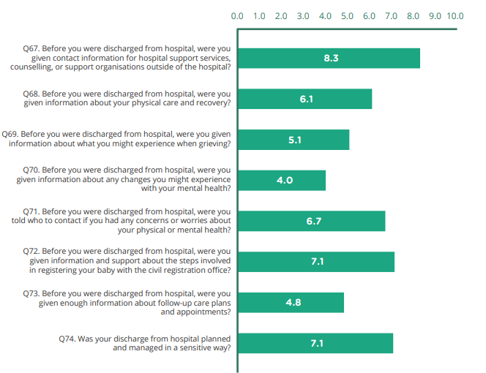
Discharge care
This stage included nine questions about the information and support provided before being discharged from the hospital. Eight of the questions were rated out of 10, and one was a free-text question.
83% (514) of participants said that they were given contact information for hospital support services, counselling or support organisations outside of the hospital.
47% (282) of participants said that they were not given information about changes they might experience with their mental health.
Figure 3.3.10 : Individual questions for ‘Discharge’.

Slide 106

Comments on Discharge care
“They organised an easy and as private as can be discharge, from a nurse waiting at the lift so no waiting, to 2 security guards standing either side of a private door away from public, and had our car waiting.”
“I was discharged with no support or information on emotional supports, grief or bereavement.”
“Leaving the hospital, I felt this could have been dealt with much more sensitively, private door, private exit etc, it was heart-breaking passing expectant mothers and couples leaving the hospital with their newborns, all the while carrying our deceased angel baby in a basket covered in a blanket, it broke our hearts and is something that really stands out in our story when we speak about our experience.”
“My voice was listened to, my many questions answered from hospital admission to discharge, I was treated with respect and dignity. I feel that the staff walked along with me, they felt my pain and they recognised the love we had for our son.”

Slide 107
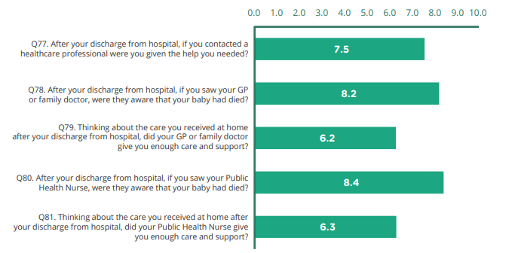
Follow-up care
Seven questions about their experiences of care at home after their discharge from the hospital, and follow-up care provided by the hospital. Five of the questions were rated out of 10.
49% (320) said that they saw a GP as part of their follow-up care.
15% (100) said that they had no follow-up care since leaving the hospital.
84% (198) said that the public health nurse was aware that their baby had died.
22% (105) said that their GP or family doctor did not give them enough care and support.
Figure 3.3.11 : Individual questions for ‘Follow up care’.

Slide 108

Comments on Follow-up care
“I feel that more information relating to follow on services, support groups could have been given.”
“My GP was made aware of our loss immediately and they made an effort to call and express their personal sympathies.”
“My GP and PHN were amazing. My GP rang me and spoke at length about any supports I needed. He made sure that both me and my husband were ok and always (and still does) ask about our emotional well-being anytime any family member has a reason to be in clinic. PHN was also very available. She was sensitive and caring. She made herself available without intruding.”
“Although the bereavement team were excellent in my baby’s funeral arrangements and gave me a booklet on aftercare etc. I only received a call to follow up on my baby’s diagnosis, there was no follow up regarding counselling or any mental health support that wasn’t off your own back.”

Slide 109
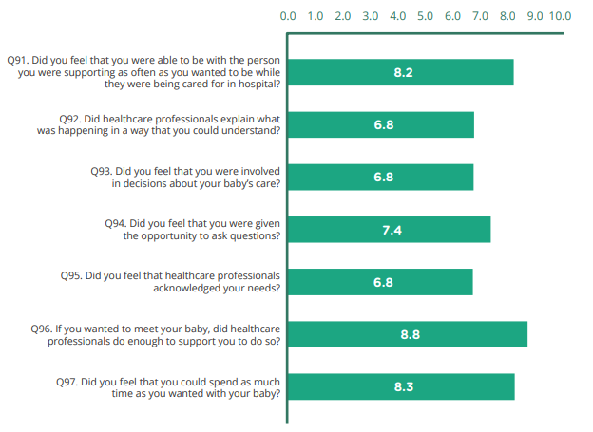
Partner or support person
Nine questions on the experience of the partner or support person present with the mother during her experience of pregnancy loss. Seven of the questions were rated out of 10.
81% (174) said that the healthcare staff ‘definitely’ did enough to support them if they wanted to meet their baby.
14% (32) said that healthcare professionals did not explain what was happening in a way they could understand.
20% (44) felt that they were not involved in decisions about their baby’s care.
17% (39) felt that healthcare professionals did not acknowledge the partner or support person’s needs.
Figure 3.3.12 : Individual questions for ‘Partner or support person’.

Slide 110

Comments on Partner or support person
“I think the hospital did as much as they possibly could have for us, staff were compassionate towards us and helped us through a tough time.”
“There was no grief counselling offered to me or my partner after the loss of our baby.”
“I was never advised of any support organisations, or how this experience could affect me, apart from my partner & family members checking in, I was never spoken to or giving advice from any health care professionals.”
“The support we received after losing our baby was exemplary. We knew before the birth that we would lose our baby. We were put in contact with a social worker who was very kind and supportive. The midwives and bereavement midwives were phenomenal. They were such a calm presence in a time of total devastation.”

Slide 111
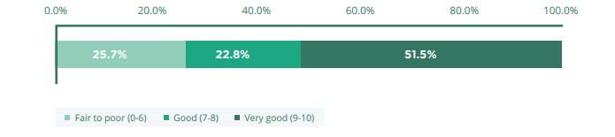
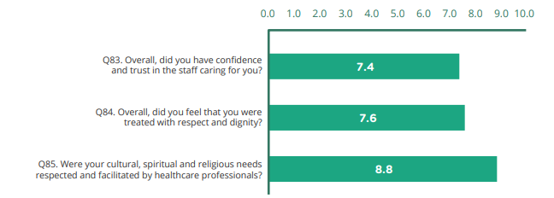
Overall care
This stage included eight questions that asked parents about their overall experience of care.
Three of these were free text to allow participants to tell us, in their own words, anything else about their care that we had not included in the survey.
The average overall rating of care was 7.6 out of 10.
62% (406) of participants said that they were always treated with respect and dignity.
Figure 3.3.13 : Overall ratings of care.
Figure 3.3.14 : Individual questions for ‘Overall experience’.

Slide 112

Comments on Overall care
“There needs to be a separate section in hospitals for women receiving bad news and not be expected to sit with women with healthy babies.”
“Sonographer and consultant handled telling us the bad news very well, very empathetic and caring.”
“Midwifes were very caring and neonatal specialist clearly explained my baby would not survive and took the time to investigate if they could intervene or not when he was born. He clearly explained all information to me.”
“The doctor who gave me the news about my baby could have been clearer about what was going to happen and what my delivery options were.”

Slide 113

Impact of COVID-19 pandemic on care experiences
The survey period covered experiences of losses both before and during the COVID-19 pandemic.
137 comments relating to the impact of the pandemic were received.
  Highlighted the impact of restrictions on partners and family members.
A comparison of experiences for each stage of care before and during the pandemic was completed, with no statistically significant difference.
Figure 3.3.15: Results for question on when participants experienced loss.

Slide 114
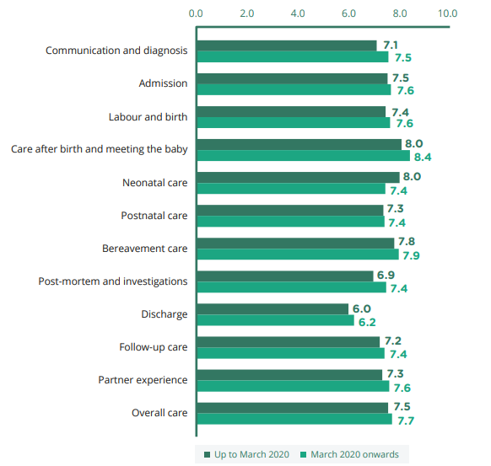
Impact of COVID-19 pandemic on care experiences
A comparison of experiences for each stage of care before and during the pandemic was completed.
Some small differences were noted, but not statistically significant.
Figure 3.3.16: Comparison of stages of care and overall care by time of loss

Slide 115
Impact of COVID-19 pandemic on care experiences
“Having to do everything alone during the pandemic was incredibly difficult. I don’t think my husband will ever understand what I went through as he was not allowed to be present for anything.”
“The staff on maternity ward were very kind and caring, and supportive. I felt cared for as I was on my own and it was during lockdown.”
“It was hard because of lockdown, but the other side, I wouldn’t have wanted too many visitors because I wasn’t able and I had sepsis and was very sick for over a week.”
“The only thing we wished different is the restrictions that were put in place because of COVID-19. It was difficult for both of us, getting bad news without my partner there.”
The pandemic affected some aspects of how care was provided, necessitating the introduction of hospital restrictions on visitors among other measures.

Slide 116


Conclusion
In total, 655 women and 232 partners or support persons responded to the survey.
Participants highlighted positive care experiences and several areas for improvement, such as:
National Maternity Bereavement Experience Survey Results 2022
Read the full reports @ yourexperience.ie/maternity-bereavement/about-the-survey

Slide 117


National End of Life Survey 2023

Slide 118

National End of Life Survey 2023
The first national survey asking bereaved relatives about the care provided to a family member or friend in the last months and days of their life.
Purpose: to learn from people’s experiences of end-of-life care in order to improve the services provided both to people who are dying and to their loved ones.

Slide 119

Who was eligible to participate?
People who registered the death of a family member or friend that occurred between 1 September and 31 December 2022.
Eligible people were sent a survey pack in the post between March and May 2023.
In cases where people were not invited to participate but felt they should have been, it was possible to opt in to the survey.
Figure 3.4.1: Inclusion and exclusion criteria

Slide 120







Questions asked in the Survey
A total of 110 questions, of which three were free text.
The survey included questions on pain management, respect and dignity, emotional support, communication with healthcare staff and the provision of information.
Figure 3.4.2: Description of settings of Care

Slide 121

Participants
9,446 people were invited to participate in the National End of Life Survey.
4,570(48.4%)returned a completed questionnaire.
31.7% (1,390): male, 68.0% (2,981): female
More than 50% were aged between 50-69.
53.6%(2409) of the participants were adult children of the person who died.
Figure 3.4.3: Age & Gender of Participants

Slide 122

National Overall experiences of care and support
Participants were asked to rate the overall care that their relative or friend received at the end of their life on a scale from 0 (very poor care) to 10 (very good care).
73.7% of participants (3,145 of 4,265) rated the care their relative or friend received at the end of their life as ‘very good’.
The most positive ratings of overall care at the end of life were from bereaved relatives of people who died in a hospice, with 93.4% of people (442 of 473).
Figure 3.4.4: Overall experiences of care at the end of life by place of death

Slide 123

Analysis of bereaved people’s comments
Three free-text questions asked participants to describe their experiences
What was good about the care your relative or friend received?
Was there anything that could have been improved?
Do you have any other comments or suggestions about the care your relative or friend received?
9,520 comments were made in response 49 codes were developed from the comments 18 themes.
Figure 3.4.5 : List of summary themes

Slide 124


What was good about the care your relative or friend received?
Frequently occurring themes: ‘Respect and dignity’, ‘General and other staff’ and ‘Physical, emotional and spiritual needs of the person who died.
“He was treated with dignity and respect during his time. All his wishes were considered from the time he entered the [nursing home]. He was brought out on visits, social occasions.”
“The nurses were the best part of the overall experience we had as a family when we lost our loved one they did the best in an overstretched work place the cleaners were so good and all the receptionist for the doctors were ever so helpful.”
Figure 3.4.6 : Responses broken down by theme

Slide 125

Was there anything that could have been improved ?
Most of the comments related to the ‘Continuity, availability and responsiveness of care’, ‘Communication’ and ‘General and other comment’ themes.
At times, he maybe struggled with his care, because he didn’t have medical care at hand. We had a carer in the house during the day, but regular scheduled medical check up by a nurse or doctor would have helped - maybe every two or three days.”
“I wish I could have been given more information about the end of life pain relief. My partner was sedated while I wasn’t there so I didn’t really get a chance to say goodbye while he was conscious. I don’t think we got enough information towards the end.”
Figure 3.4.7 : Responses broken down by theme

Slide 126

Comments or suggestions about the care your relative or friend received?
Frequently occurring themes: ‘Continuity, availability and responsiveness of care’, ‘Experience of care in hospital’ and ‘Physical, emotional and spiritual needs of the person who died’.
“If everyone receives this level of care at the end, it’s to be commended. It felt like a co-ordinated mission by all to give my mother the most comfort and dignity during the toughest period of her life.”
“Visiting was very limited in the hospital setting, even though my relative could not communicate with the staff. When palliative care was mentioned, care became disjointed and my husband was embarrassed and very sad at the way he was treated and cared for.”
Figure 3.4.8 : Responses broken down by theme

Slide 127


Care at Home
46.1%(1164) said that someone from a hospice, community palliative care team or other specialist palliative care service visited their relative or friend in the last three months of their life.
39.1% (579 of 1,482 ) said that the GP was not available to visit if their relative or friend required a home visit from the GP for help with urgent problems outside of normal working hours.
78.1% of participants (1,822 of 2,332) rated the overall care received from healthcare staff at home in the last three months as ‘good’ or ‘very good’.
Figure 3.4.9 : Scores for questions on ‘care at home’

Slide 128

Comments from participants on Care at Home
“The public health nurse couldn’t have been kinder, more supportive, professional and knowledgeable. He called to the house almost daily and did everything in his power to respect my mothers wishes and care for her with such compassion.”
“My mother wanted to die at home. Hospice would have probably found it easier if she would have been admitted but they provided us with all the support we needed so that she could die at home.”
“Support from the Palliative Care team in the final days was limited. They were very nice people with loads of experience and wisdom but they seemed to be very stretched. We had our final visit 2.5-3 days before he died. After that we just got telephone support.”
“When he came home for 6 weeks, his care was distributed to all different teams in the community. This was very hard on my husband and I. I spent all my time trying to contact them.”

Slide 129


Care in a nursing home or residential care facility
1,671 participants said that their relative or friend had stayed in a nursing home or residential care facility during the last three months of their life.
84.8% of people (1,337) said that they always felt welcome to visit their friend or relative at any time.
10.4% of participants (147) said that healthcare staff did not support their relative or friend to do things they wanted to do.
85.4% of participants rated the overall care their relative or friend received from care facility in the last three months of their life as ‘good’ or ‘very good’.
Figure 3.4.10 : Scores for questions on ‘Care in a nursing home or residential care facility’

Slide 130
Comments from participants on Care at external facility
“My relative spent the last years
of her life in a ‘home from home’
environment (nursing home). Her
needs were met in every way -
activities, excursions, visits from
relatives at times outside of visiting
hours, spiritual needs, good food and
nice clean surroundings all met.”
“I feel she got good care in the nursing home. Unfortunately COVID restrictions didn’t allow us to visit our aunt, and she was very upset and felt isolated as she was confined to her room the week prior to her death. We were also upset by this.”
“I wonder if more conversations
should happen in nursing homes
and with older people’s services
about decisions when medical
treatment should/or should not
be made. I was very clear on
my father’s wish regarding DNR
but never had thought I would
ever be deciding whether or
not he should go to hospital for
treatment.”
“The nursing home were very attentive
to dad and nothing appeared to be a
challenge. They made contact with us
at all times in relation to any change
in his care. They had a good visiting
policy in place that was user friendly
to us as a family.

Slide 131

Care in a hospital
2,639 people said that their relative or friend had spent time in an acute hospital.
64.6% of participants (1,627 of 2,520) said that healthcare staff did everything they could to relieve their relative or friend’s pain.
44.3% of people (968 of 2,737) said that healthcare staff did not help and support their relative or friend with their emotional needs
71.1% of participants (1,930 of 2,716) rated the overall care in an acute hospital as ‘good’ or ‘very good’.
Figure 3.4.11 : Scores for questions on ‘Care in an acute hospital’

Slide 132
Comments from participants on Care in Hospital
“I could visit at any time.
Encouraged to stay overnight.
He was given pain relief when
needed and his position
changed frequently.”
“Nurses and care staff were excellent.
They always kept us up to date on how
Uncle was doing. He was made very
comfortable, warm and safe. He was
so well looked after by all the team.”
“Her stay in the hospital was
unsatisfactory. Very poor
communication between the staff.
Overall very stressful to experience
what mum went through while she
was there, not given enough pain
relief or care or compassion.”
“The lack of information while in the hospital setting was extremely poor and upsetting, there was no-one to talk to until my dad was being discharged.”

Slide 133

Care in a hospice
540 participants said that their relative or friend had spent time in a hospice
96.3% of relatives (523 of 543) said that their relative or friend was always treated with respect and dignity by healthcare staff.
6.5% of participants (25 of 383) said that healthcare staff did not support their relative or friend to do things they wanted to do.
97.4% of participants (526 of 540) rated the care received in the hospice as ‘good’ or ‘very good’.
Figure 3.4.12 : Scores for questions on ‘Care in a hospice’

Slide 134
Comments from participants on Care in Hospice
“Hospice was peaceful and at all times Mam was cared for to the highest standard, treated with respect, love, kindness and dignity by all. I was also treated with respect and kindness and involved in all aspects of her care. Staff were excellent and communicated clearly and available to talk at all times.”
“Owing to the underlying mental health needs of the person who died, hospice staff made every effort to understand and learn more about these needs, so compassionate and professional.”
“The level of care, support and
sensitivity towards both patient and
family was beyond all expectations in
the hospice... Wonderful people each
and every one of them with exceptional
empathy, skills and a depth of both
knowledge and ability to genuinely care
for and support the most vulnerable of
people day in day out. Thanks to all.”
“The lack of information while in the hospital setting was extremely poor and upsetting, there was no-one to talk to until my dad was being discharged.”

Slide 135


Care in the last two days
1,023 people were cared for at home, 1,273 in a nursing home or other residential care facility, 1,662 in an acute hospital and 496 in a hospice.
Dad was moved to a private room for the last days but considering how sick he was, I felt this should have happened sooner.
I am grateful to the experienced home help who saw my mother was suffering pain, and got the district nurse to arrange a palliative care nurse to come and Doc to prescribe morphine in the last 2 days of my mother’s life.
Figure 3.4.13 : Location of care in the last two days of life

Slide 136

Care in the last two days
Home: 1,023 people were cared for at home during the last two days of their life, while 1,025 people died at home.
94.6% of bereaved relatives (742 of 784) said that their relative or friend was always treated with kindness and compassion.
39.8% of people (159 of 399) saying that healthcare staff did not provide support to meet religious or spiritual needs.
Nursing Home/Residential Facility : 1,273 people were cared, while 1,251 people died in a nursing home or residential care facility.
91.9% of bereaved relatives (1,067 of 1,161) said that their relative or friend was always treated with kindness and compassion.
6.5% of people (26 of 397) said that their relative or friend was not as involved in decisions about their care and treatment.
Hospital : 1,662 people were cared for in hospital, while 1,799 people died in hospital.
86.4% of bereaved relatives (1,454 of 1,682) said that they were always treated with kindness and compassion.
15.6% of people (156 of 1,002) said that healthcare staff did not help with their emotional needs
Hospice : 496 people were cared for in a hospice, while 487 people died in a hospice.
98.3% of bereaved relatives (464 of 472) said that their relative or friend was always treated with kindness and compassion.
6.4% (15 of people 236) said that the healthcare staff did not break the news to them in a sensitive and caring way.

Slide 137


Bereaved Relatives experience of care & support
84.3% of participants (3,546 of 4,329) said that healthcare staff always sensitively engaged with them after their relative or friend died.
29.0% of participants (542 of 1,871) said that healthcare staff did not provide enough help and support to talk to children or young adults about their relative or friend’s illness.
Figure 3.4.14 : Bereaved relatives’ overall experiences of care and support
Figure 3.4.15 : Scores for questions on bereaved relatives’ experiences of care and support

Slide 138

Care experience in different settings
The majority received care across more than one of these settings in the last months and days of their lives, approximately 1.6 settings on average.
45.4% participants (1,699) answered that there ‘definitely’ was good coordination between the services and staff in the last three months.
73.6% participants (3,007) answered that there was ‘definitely’ good coordination between the services and staff in the last two days.
Figure 3.4.16 : Place of death, compared by settings where care was received in
the last three months of life

Slide 139

Conclusion
The majority received care across more than one of these settings in the last months and days of their lives, approximately 1.6 settings on average.
Most participants had confidence and trust in healthcare staff and felt that their relative or friend was always treated with respect, dignity, kindness and compassion.
Of the settings covered in the survey, hospitals were the most common place of death, &Hospices received the most positive ratings.
Areas for improvement mentioned by the participants: continuity, availability and responsiveness of care; and a desire for clearer and more consistent communication.

Slide 140


National Mental Health Experience Survey 2025

Slide 141
The National Mental Health Experience Survey is the first national survey of its kind in Ireland, asking people about the care provided in inpatient mental health units or hospitals.
The purpose of the survey is to learn from people’s experiences of inpatient mental health care and services to improve the care provided in these settings.

Slide 142
Survey themes and questions
The themes covered by the questions in the National Mental Health Experience Survey include:
Admission
Your care and treatment
Interactions with staff in the mental health unit or hospital
Family, friends and carers
Discharge, planning and care
Follow-up care
Overall care
Restrictions/restrictive practices
Mental health tribunal process experience

Slide 143
Survey implementation plan
To be eligible to participate, an individual must have been discharged from an inpatient mental health unit or hospital during an agreed three-month period.
Eligible people receive a survey pack in the post between following discharge.
The survey remains open for a minimum of eight weeks following receipt of the survey questionnaire.
The results are analysed and reports prepared for publication.
Survey period
Invitations sent
Survey closes

Slide 144

National Cancer Care Experience Survey

Slide 145
National Cancer Care Experience Survey
The National Cancer Care Experience Survey will be the first national survey asking people who have received cancer care and treatment about their experiences of care in public and voluntary hospitals in the Republic of Ireland.
The purpose of the survey :
To learn from people’s experiences of cancer care, acknowledging what is working well and where areas of improvement are needed. This will help
To ensure appropriate and consistent care is provided to all cancer patients in the future.

Slide 146
Survey themes and questions
The survey contains questions on:
  Living well with and beyond cancer
  Deciding on the best treatment
  Support and care from hospital staff
  Coordination of care
The themes covered include:
  Provision of information
  Communication across the multidisciplinary team
  Choice
  Shared decision making

Slide 147
Work carried out to date:
National Review
International Review
Focus Groups
Gap analysis
Delphi Study
Methodology proposal

Slide 148
Survey Implementation
At present, no date has been agreed to implement the National Cancer Care Experience Survey.
The survey questionnaire will be developed by Summer 2025.

Slide 149

Section 4.
Impact

Slide 150
Impact
Measuring and reporting on the impact of projects promotes transparency, allows for the evaluation of a project against its stated objectives and demonstrates the effectiveness of a programme.
HIQA has developed a framework to support the measurement of impact through a combination of measures, including:
Outputs
Tangible entitites produced from projects
Reach
One-way communications about a project
Promotional material, information sessions
Engagement
Two-way communication about a project
Conferences, training programmes
Change
Changes in patient experience scores
Changes in practice/policy in response to the survey
Reports, policies, quality improvements

Slide 151








2022-2024 Impact
5
We implemented the National Nursing Home Experience Survey, National Maternity Bereavement Experience Survey, National End of Life Survey and National Inpatient Experience Survey (2022 and 2024).
.
Surveys implemented
30,389
Nursing home residents, their relatives and friends, bereaved parents, bereaved relatives and people admitted to public acute hospitals told us about their experiences of care.
Survey participants
90
We published national, local and themed reports of survey findings.
Reports published
160⁺
Engagements
with stakeholders
We held information sessions and calls with our stakeholders.
46
Lectures, presentations
and posters
We delivered guest lectures, facilitated workshops and presented at national and international conferences.

Slide 152

Quality Improvement
Results from surveys inform the development of quality improvement plans
Examples of quality improvement initiatives
Patient partnership and promoting feedback
University Hospital Waterford put a patient partnership forum in place and has undertaken work to develop information booklets, banners, suggestion box to help encourage feedback from patients.
Patient feedback
Multiple hospitals have launched electronic patient feedback forms which has increased submissions.
Food
Picture menus have been introduced along with electronic food ordering to reduce errors. Menu choices have been increased (vegan, halal, etc.). Availability of food outside of set meal times has increased. Improved tracking of missed meals has also been introduced.
HSE-Response NIES 2024

Slide 153


Quality Improvement continued
(National Inpatient Experience Survey)
Results from surveys inform the development of quality improvement plans
Examples of quality improvement initiatives (continued)
Communication
“John’s campaign” in Letterkenny University Hospital is an initiative to support patients with cognitive impairment or communication difficulties and has led to the development of an updated visiting policy, carer’s passport and other information materials. Multiple hospitals have also rolled out patient passports for people living with dementia. “Getting to know what matters to me” documents have been implemented in Letterkenny University Hospital and Portiuncula University Hospital. Easy to read patient information booklet was developed and launched in University Hospital Waterford.
Accessibility
St. Luke’s Hospital has developed a plain English booklet about the hospital and guides to support people whose first language is not English.
Examples of information booklets developed

Slide 154
Communication and information (2022 and 2024)
2022:
“Two young doctors were very good, explained everything and answered any questions I asked.”
2024:
“The doctor that was on
the care team came back to me when the team had left to make sure I understood what was wrong and explain to me in a way I could understand.”
“The communication between doctor and discharge co-ordinator and family was excellent.”
“The staff, particularly the nursing staff were excellent. They were attentive and caring. Pain relief was delivered promptly and communication was excellent.”
“Communication with doctors. I was unable
to understand and my family could not get
an opportunity to speak with the doctor.”
“I have aphasia because of a stroke, so have difficulty understanding and cannot speak. Efforts should be made to provide staff and doctors with information about how to communicate with a patient with a condition like this…”

Slide 155


Quality Improvement
(National End of Life Survey)
The findings of the National End of Life Survey were welcomed by the HSE and national representative organisations for nursing homes
The HSE has used results from the National End of Life Survey to inform the development of quality improvement plans.
The Irish Hospice Foundation used the findings from the National End of Life Survey to inform and launch their Time to Talk Campaign, which aims to normalise conversations about dying and grieving.
HSE-Response NELS 2023
Time to Talk Campaign

Slide 156

Caru
Caru was established in November 2022 in direct response to the recommendations of the COVID-19 Nursing Homes Expert panel.
It aims to support and empower nursing homes and their staff in delivering palliative, end-of-life, and bereavement care.
The findings of the National End of Life Survey will help Caru achieve its aims.

Slide 157

Implementation of the National Maternity Strategy
The results of the National Maternity Experience Survey have informed funding for services, including new lactation consultant posts and improved postnatal supports.
  Five pilot Postnatal hubs were established in Cork, Carlow-Kilkenny, Portiuncula and Sligo.
  Four new hubs are being developed at Dublin's three maternity hospitals and Our Lady of Lourdes, backed by €1.9 million in annual funding from the Women’s Health Taskforce.
  €2 million in new funding for the National Maternity Strategy 2025 will add four more hubs, expanding the network to 13.

Slide 158

National Standards for Bereavement Care
The National Maternity Bereavement Experience Survey highlighted many positive experiences, as well as improvements required across maternity services.
Quality improvement plans have been developed by the HSE across hospitals
Improvements in bereavement care continue to be driven through the National Maternity Strategy, including progressive implementation of the National Standards for Bereavement Care.
Specialist bereavement teams have now been established in all 19 maternity services.

Slide 159
Health Systems Performance Assessment
The Health Systems Performance Assessment Framework (HSPA) is a measurement tool for assessing the overall performance of the health system in Ireland.
Within the current suite of indicators, the National Care Experience Programme and the range of surveys are an important input into the domain of person-centredness.
This ensures that data on patient-reported experiences is captured as part of the framework.
The HSPA is available on https://hspa.gov.ie/

Slide 160

Organisation for Economic Co-operation and Development
The Department of Health is a member of the OECD’s Healthcare and Quality Outcomes Working Party.
As part of its work, the HCQO WP does a biennial data collection
In 2025, Ireland submitted data for the first time related to the National Inpatient Experience Survey.
The data will be published on the OECD’s Data Explorer database in early July 2025 - https://data-explorer.oecd.org/

Slide 161
Section 5.
Useful resources

Slide 162


Website
More information about the National Care Experience Programme, as well as each of the programme’s surveys, is available on www.yourexperience.ie.
The website includes links to reports and publications, interactive survey results, and the Survey Hub.
https://yourexperience.ie/inpatient/interactive-charts/

Slide 163

Survey Hub
The Survey Hub provides a lot of useful material to use when developing surveys and understanding survey results.
It also contains information on various research projects that utilise data from the National Care Experience Programme, including publications, conference posters and presentations.
There are seven e-learning modules available:
  Introduction to survey design
  Questionnaire design
  Survey administration
  Survey data
  Analysing and presenting survey findings
  National Care Experience Programme interactive dashboards
  Data Access

Slide 164

Let’s Talk Care Experience podcast
This podcast discusses all aspects of people’s experiences of Ireland’s health and social care services. The podcast features people who use services, staff within services, as well as leading health and social care experts
The results of the 2024 National InPatient Experience survey
The results of the 2023 National End of Life survey
The importance of effective communication between hospital staff and patients
The importance of supporting patients while in hospital
The importance of listening to experiences of maternity bereavement care
Ireland’s First National End of Life Survey
You can also listen to the podcasts @
For apple podcasts here - https://podcasts.apple.com/podcast/id1595638638
For Spotify link https://open.spotify.com/show/375wVXltennX4cU8AXQMhm

Slide 165




Publications
In addition to reports of survey findings, the National Care Experience Programme has published a number of peer-reviewed papers.
Examples include:
Women’s experiences of infant feeding shortly after birth.
Maternity care pathway and involvement in decision making
Experiences of shared decision making in acute hospitals
  Dying, death and bereavement:
  developing a national survey of bereaved relatives

Slide 166

Requesting data for research
NCEP survey data can be requested for research purposes:
Read the Data Access Request Policy 2020
Download and complete the Data Access Request Form
Submit the request
  By email: info@yourexperience.ie
  By post: National Care Experience Programme
  Health Information and Quality Authority
  Unit 1301, City Gate
  Mahon, Cork. T12 Y2XT.
https://yourexperience.ie/about/contact-us/request-data-for-research/

Slide 167



THANK YOU
QUESTIONS
Follow us on:
If you found this slide deck useful, or have any comments or suggestions, we would love to hear from you! Please contact us at info@yourexperience.ie.

